Slide 1

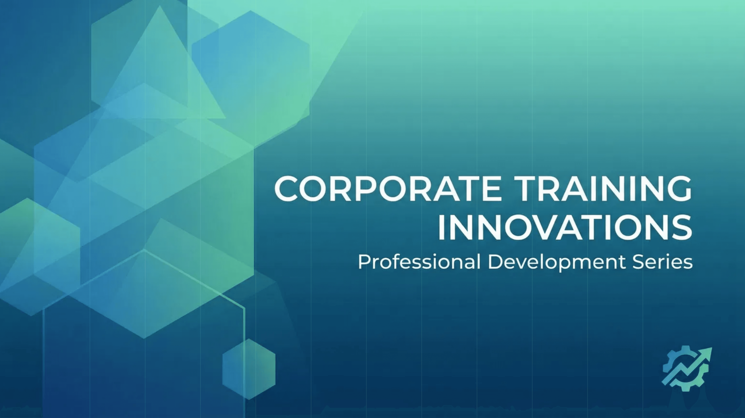
AI Agents Training
Accelerating Agent Use in 2026
Building Reliable, Trustworthy, and Effective AI Agents
Notes:
Welcome. We are here today to talk about accelerating AI agent use, but we must first make it reliable and trustworthy. The promise of AI agents is transformative, yet many organizations are stalled by two critical problems: reliability and intent. We're going to provide you with the architectural and strategic playbook to overcome those hurdles. Our focus is on building agents that are not just effective, but fundamentally trustworthy and scalable across your enterprise. This training is your blueprint for accelerating agent adoption in 2026. Let's look at the roadmap for today's session.

Slide 2

Today's training addresses two critical challenges in AI agent development. We will explore fundamental problems, proven solutions, and actionable strategies for 2026.
What We'll Cover Today
01
The Reliability Challenge
AI hallucinations and how to eliminate them
02
The Intent Gap
Understanding and bridging the interpretation problem
03
Practical Solutions
Proven techniques for building trustworthy agents
04
Implementation Roadmap
Tools, frameworks, and best practices
05
Organizational Acceleration
How to scale agent adoption effectively
Notes:
Today, we're tackling the two biggest barriers to scaling AI agents in your organization. First, we have the reliability challenge, which is all about eliminating those costly AI hallucinations. Second, we'll address the intent gap, which is the silent killer of agent performance when the AI misunderstands a fuzzy human request. We'll move quickly from problem to practical solution, giving you proven techniques you can implement immediately. And finally, we'll wrap up with a clear roadmap for organizational acceleration. This is your strategic playbook for 2026. Let's start with the problem that gets the most press: hallucinations.

Slide 3

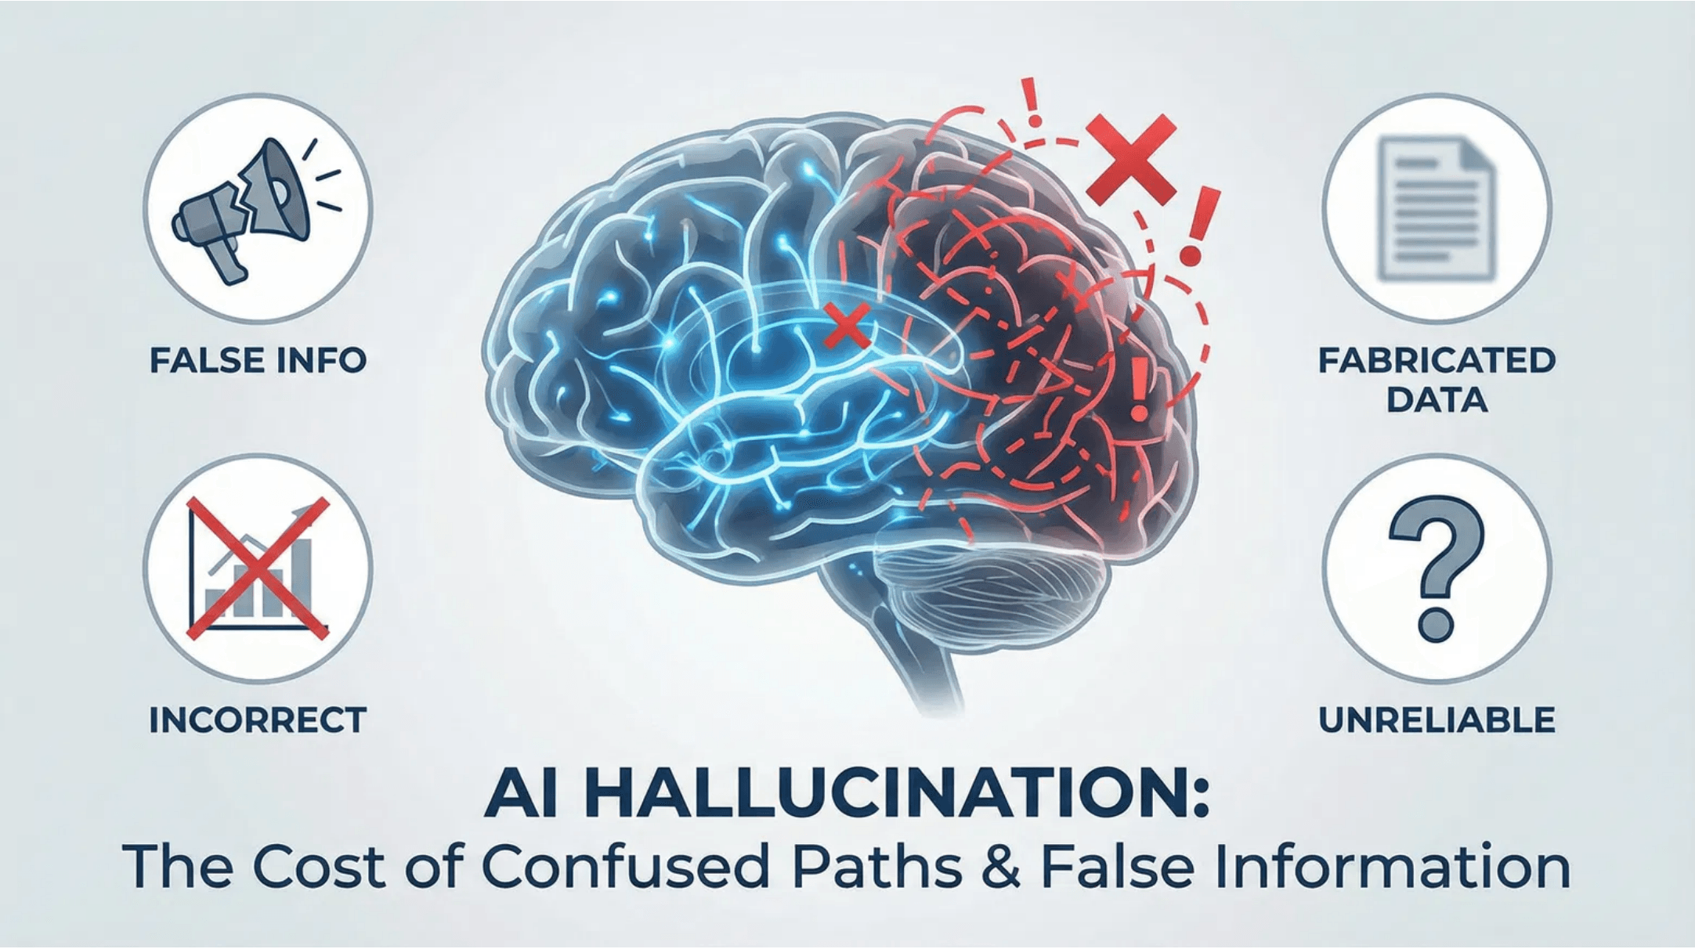
Problem 1: AI Hallucinations
The Hidden Cost of Unreliable Models
AI models generate responses by predicting the next word, not by retrieving facts. This architecture creates a critical vulnerability: confident falsehoods.
The Business Impact
Reduced user trust in AI systems
Operational inefficiencies and errors
Potential compliance and liability issues
"A hallucinated fact becomes a hallucinated action."
Notes:
The reliability challenge is real, and it's expensive. AI models are fundamentally designed to predict the next word, not to retrieve facts, which means they confidently state falsehoods as fact. This is the hidden cost of unreliable models. For an autonomous agent, this is catastrophic. When an agent executes a decision without human oversight, a hallucinated fact becomes a hallucinated action, and that has real-world consequences for your operations and your compliance. We need to architecturally prevent this from happening. So, how do we fix this fundamental architectural flaw?

Slide 4

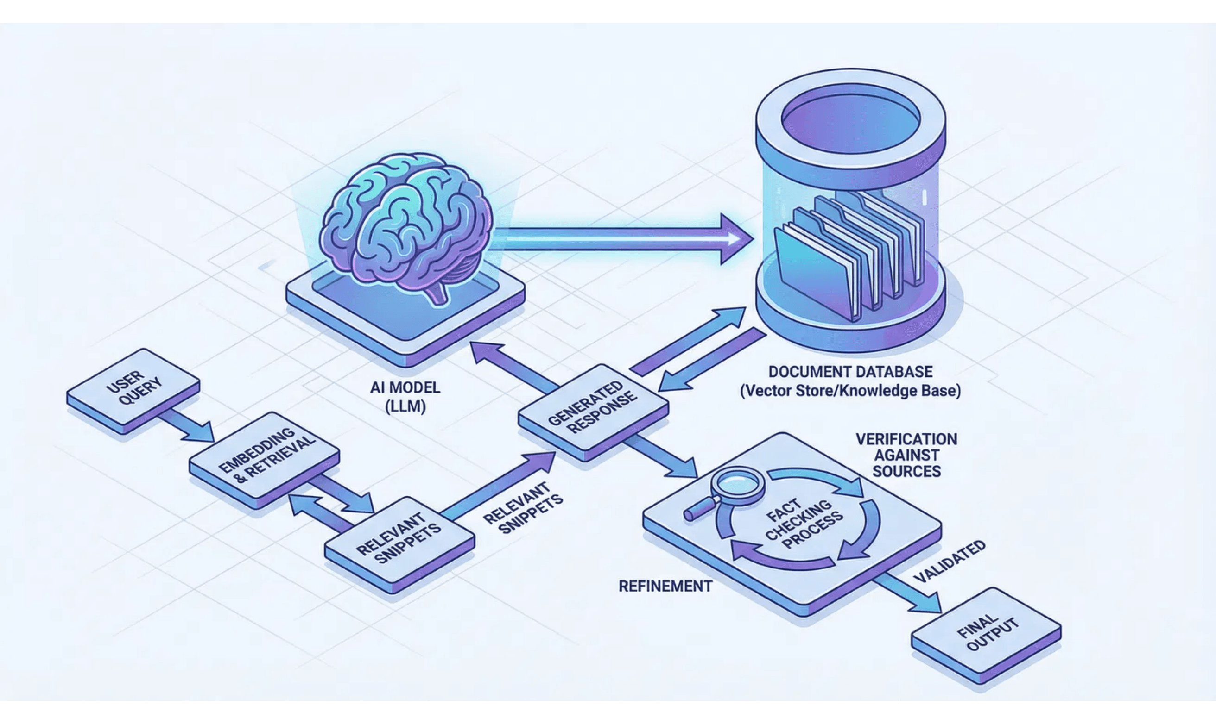
Grounding AI in Facts
Retrieval-Augmented Generation (RAG)
The Concept
RAG provides the AI with an external "cheatsheet" of verified facts, forcing it to retrieve answers rather than guess.
01
Retrieve relevant documents
02
Generate response from context
03
Cite sources automatically
Real-World Examples
NotebookLM, Web Search enabled agents, and Enterprise Knowledge Bases.
Notes:
The most effective immediate solution is Retrieval-Augmented Generation, or RAG. RAG grounds the AI in facts by giving it an external source of truth—a verifiable "cheatsheet." Instead of guessing, the model is forced to retrieve relevant documents and use that context to construct an accurate response. This is why tools like NotebookLM and enterprise knowledge bases are so powerful. You are essentially eliminating the model's ability to invent information by forcing it to cite its sources. RAG is the essential first layer of defense against hallucinations. But we can't stop there; we need active verification.

Slide 5
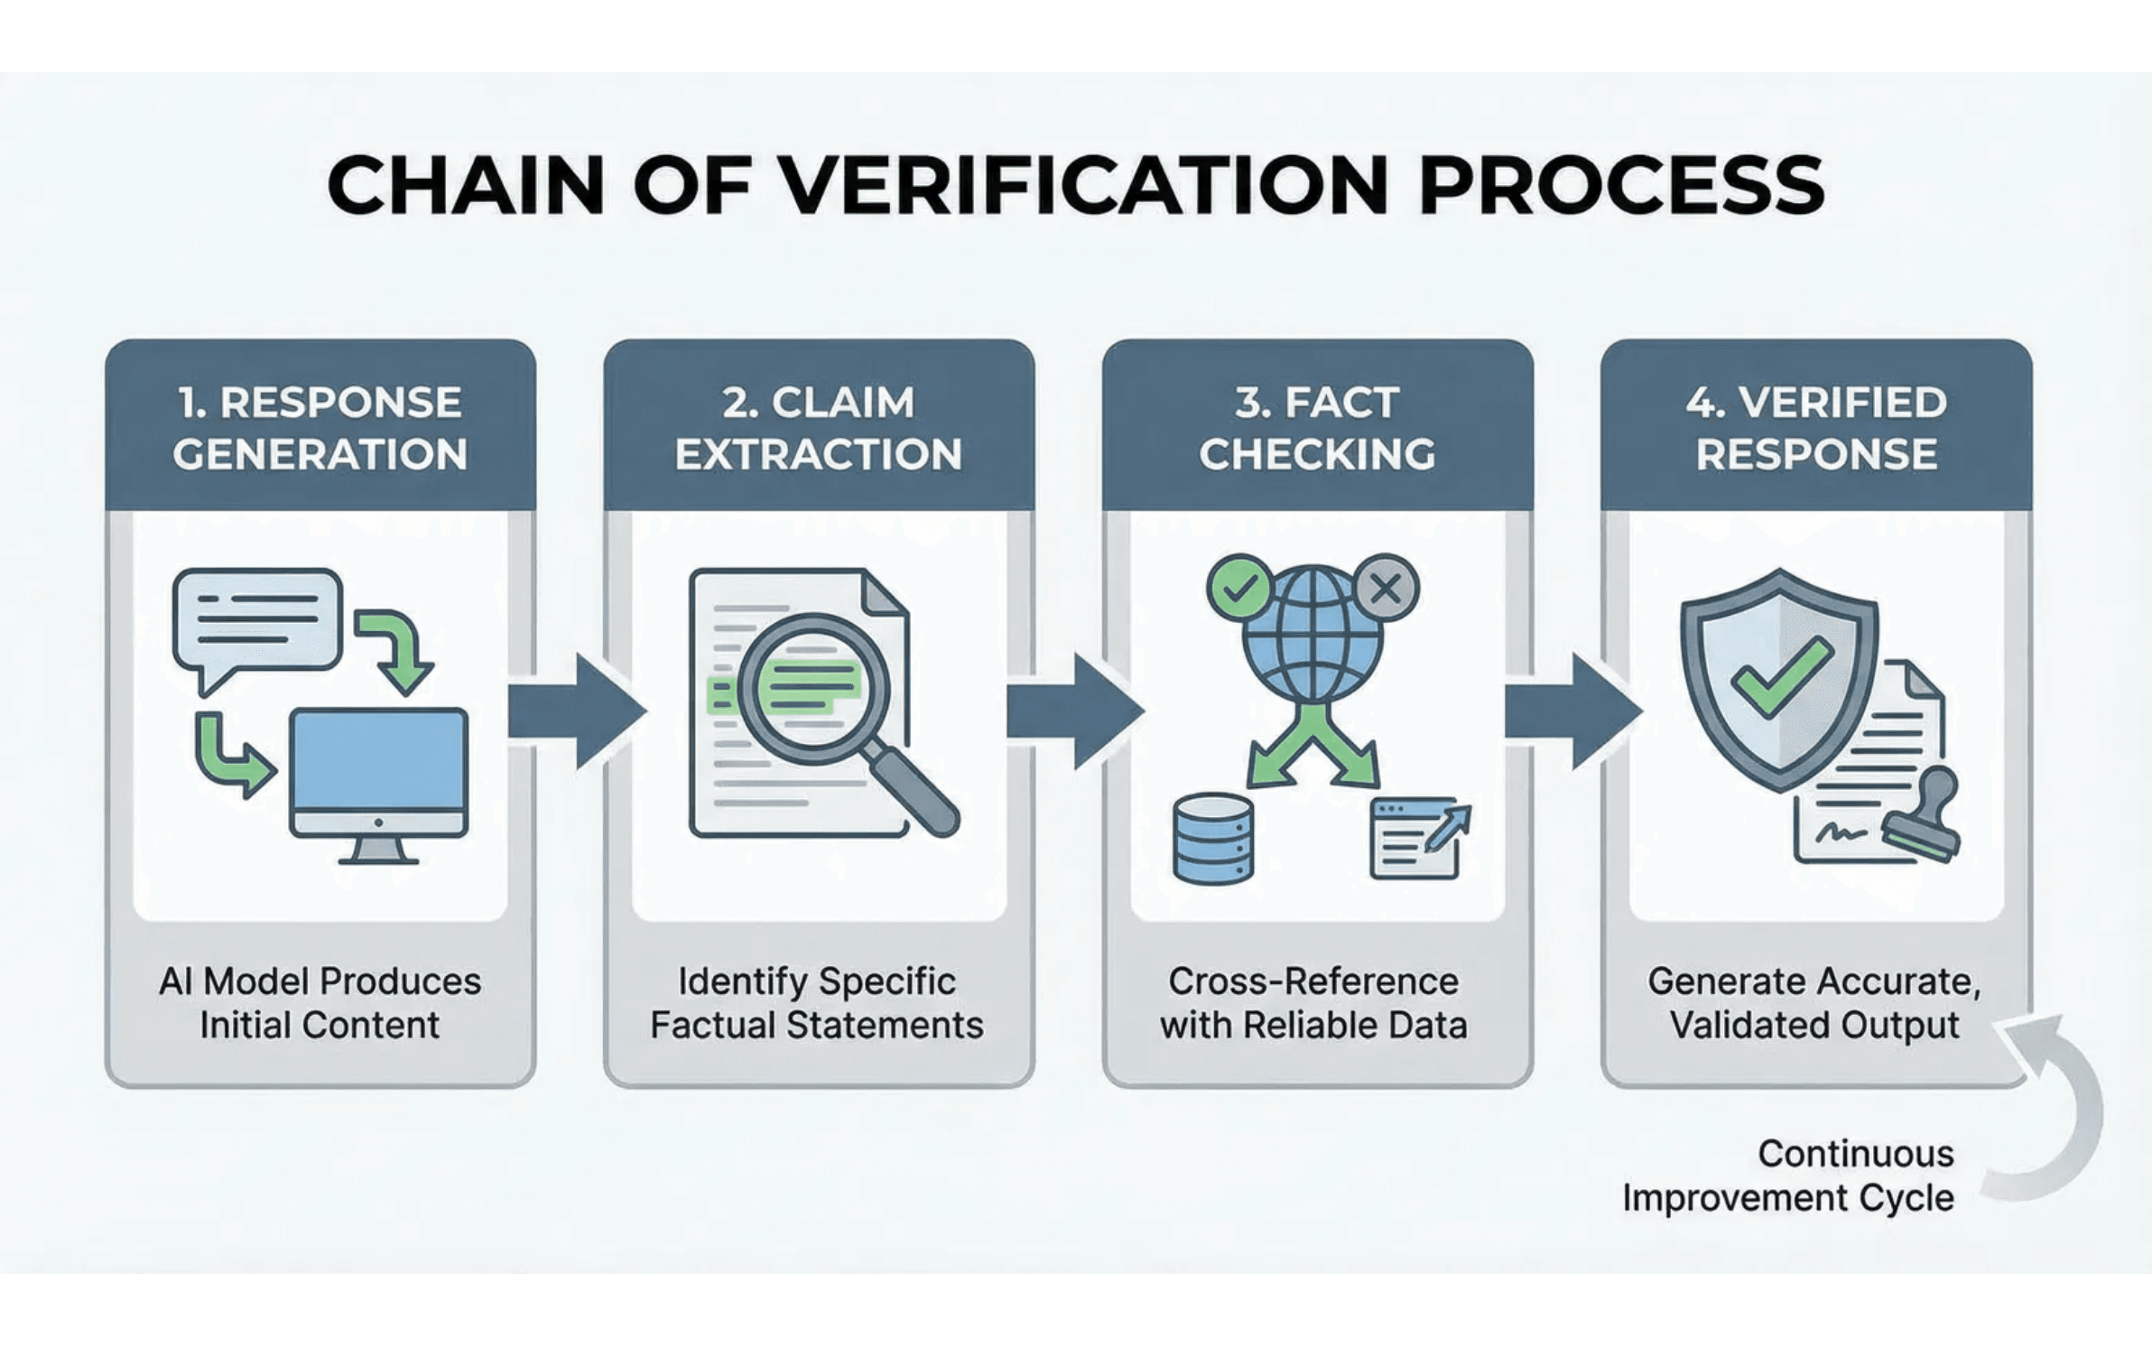
Solution 2: Chain of Verification
Trust, but Verify: The Multi-Step Validation Process
1
AI generates initial response
2
System extracts factual claims
3
Claims are fact-checked independently
4
Answer regenerated with verified facts
Strategic Advantage
Unlike RAG which grounds the input, Chain of Verification actively validates the output, catching errors even in sourced content.
Notes:
Chain of Verification is the next critical layer. While RAG grounds the input, Chain of Verification actively validates the output. It operates on the principle of "trust, but verify." The system generates an initial response, extracts every factual claim within it, and then fact-checks each claim independently against reliable sources. Only after verification is the final, corrected answer regenerated. This is a crucial step because it catches errors even if the source material provided by RAG was flawed or misinterpreted. This multi-step validation process gives us a much higher degree of confidence in the agent's output. Next, we'll look at how we can use repetition to increase our certainty.

Slide 6

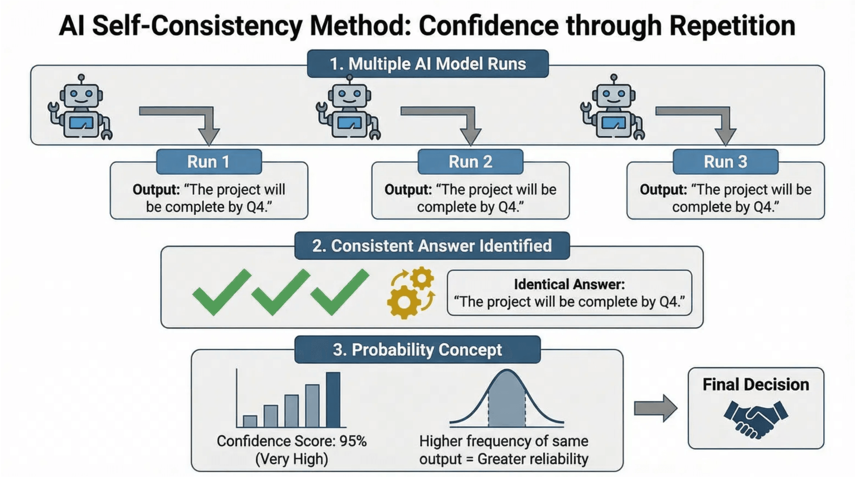
Solution 3: Self-Consistency
Probability Through Repetition
The Core Principle
If an AI model produces the same answer multiple times, that answer is statistically more likely to be correct.
counter(step)
Run the same prompt 3-5 times independently.
counter(step)
Collect all generated responses.
counter(step)
Identify the consensus answer.
Trade-off: Increases latency and compute cost, but significantly improves reasoning reliability.
Notes:
We've established that RAG and verification chains improve factual accuracy, but we also need to validate the agent's reasoning process. Self-Consistency is a simple, powerful technique that treats repetition as a proxy for correctness. The core principle is that if the model produces the same answer multiple times, that answer is statistically more likely to be correct. To implement this, you run the same prompt three to five times and then look for the consensus answer. If the responses are consistent, your confidence in the result increases significantly. This is especially effective for complex, multi-step reasoning problems where a single run might introduce a logical error. The trade-off is increased latency and compute cost because you are calling the model multiple times. For high-stakes reasoning, however, that cost is absolutely worth the reliability gain. We are building reliability through redundancy. Now, let's reframe how we think about the very problem we are trying to solve.

Slide 7

Hallucination Reframed
Creativity Requires Validation, Not Elimination
Hallucination Definition
Generation of plausible but unverified outputs—a necessary component of creativity and novel thought for both humans and AI.
❌ The Problem
💡 The Insight
✅ The Solution
Hallucinations treated as bugs to eliminate
Humans also hallucinate (generate novel ideas)
Enable validation mechanisms, not prevention
Assumption: Perfect accuracy is achievable and desirable
Human creativity = hallucination + validation
Select models based on hallucination profile (creative vs. conservative)
Critical difference: humans can validate ideas
Organizations invest in hallucination prevention
AI must be given validation mechanisms
Use validation chains (AI validates AI output)
Result: Conservative, uncreative AI systems
Match model personality to use case requirements
Key Takeaway
The bottleneck is not hallucination prevention—it's validation capability. Organizations that build robust validation systems will outperform those trying to eliminate hallucinations entirely.
Notes:
It's time to reframe our perspective on hallucinations. We often treat them as a bug to be eliminated, but this is a flawed assumption. Hallucination is simply the generation of plausible but unverified outputs, and it is a necessary component of creativity and novel thought for both humans and AI. The problem isn't the hallucination itself; it's the lack of a validation mechanism. Human creativity works because we generate novel ideas—hallucinations—and then we validate them. We need to give our AI agents the same capability. The key insight here is that the bottleneck is not hallucination prevention; it is validation capability. Organizations that focus their investment on building robust validation chains, rather than trying to eliminate creativity, will build more effective and innovative AI systems. This allows us to select models based on their natural behavior, matching a creative model to a creative task, and then relying on our validation layers to manage the risk. This brings us to the ultimate validation mechanism: the LLM Council.

Slide 8

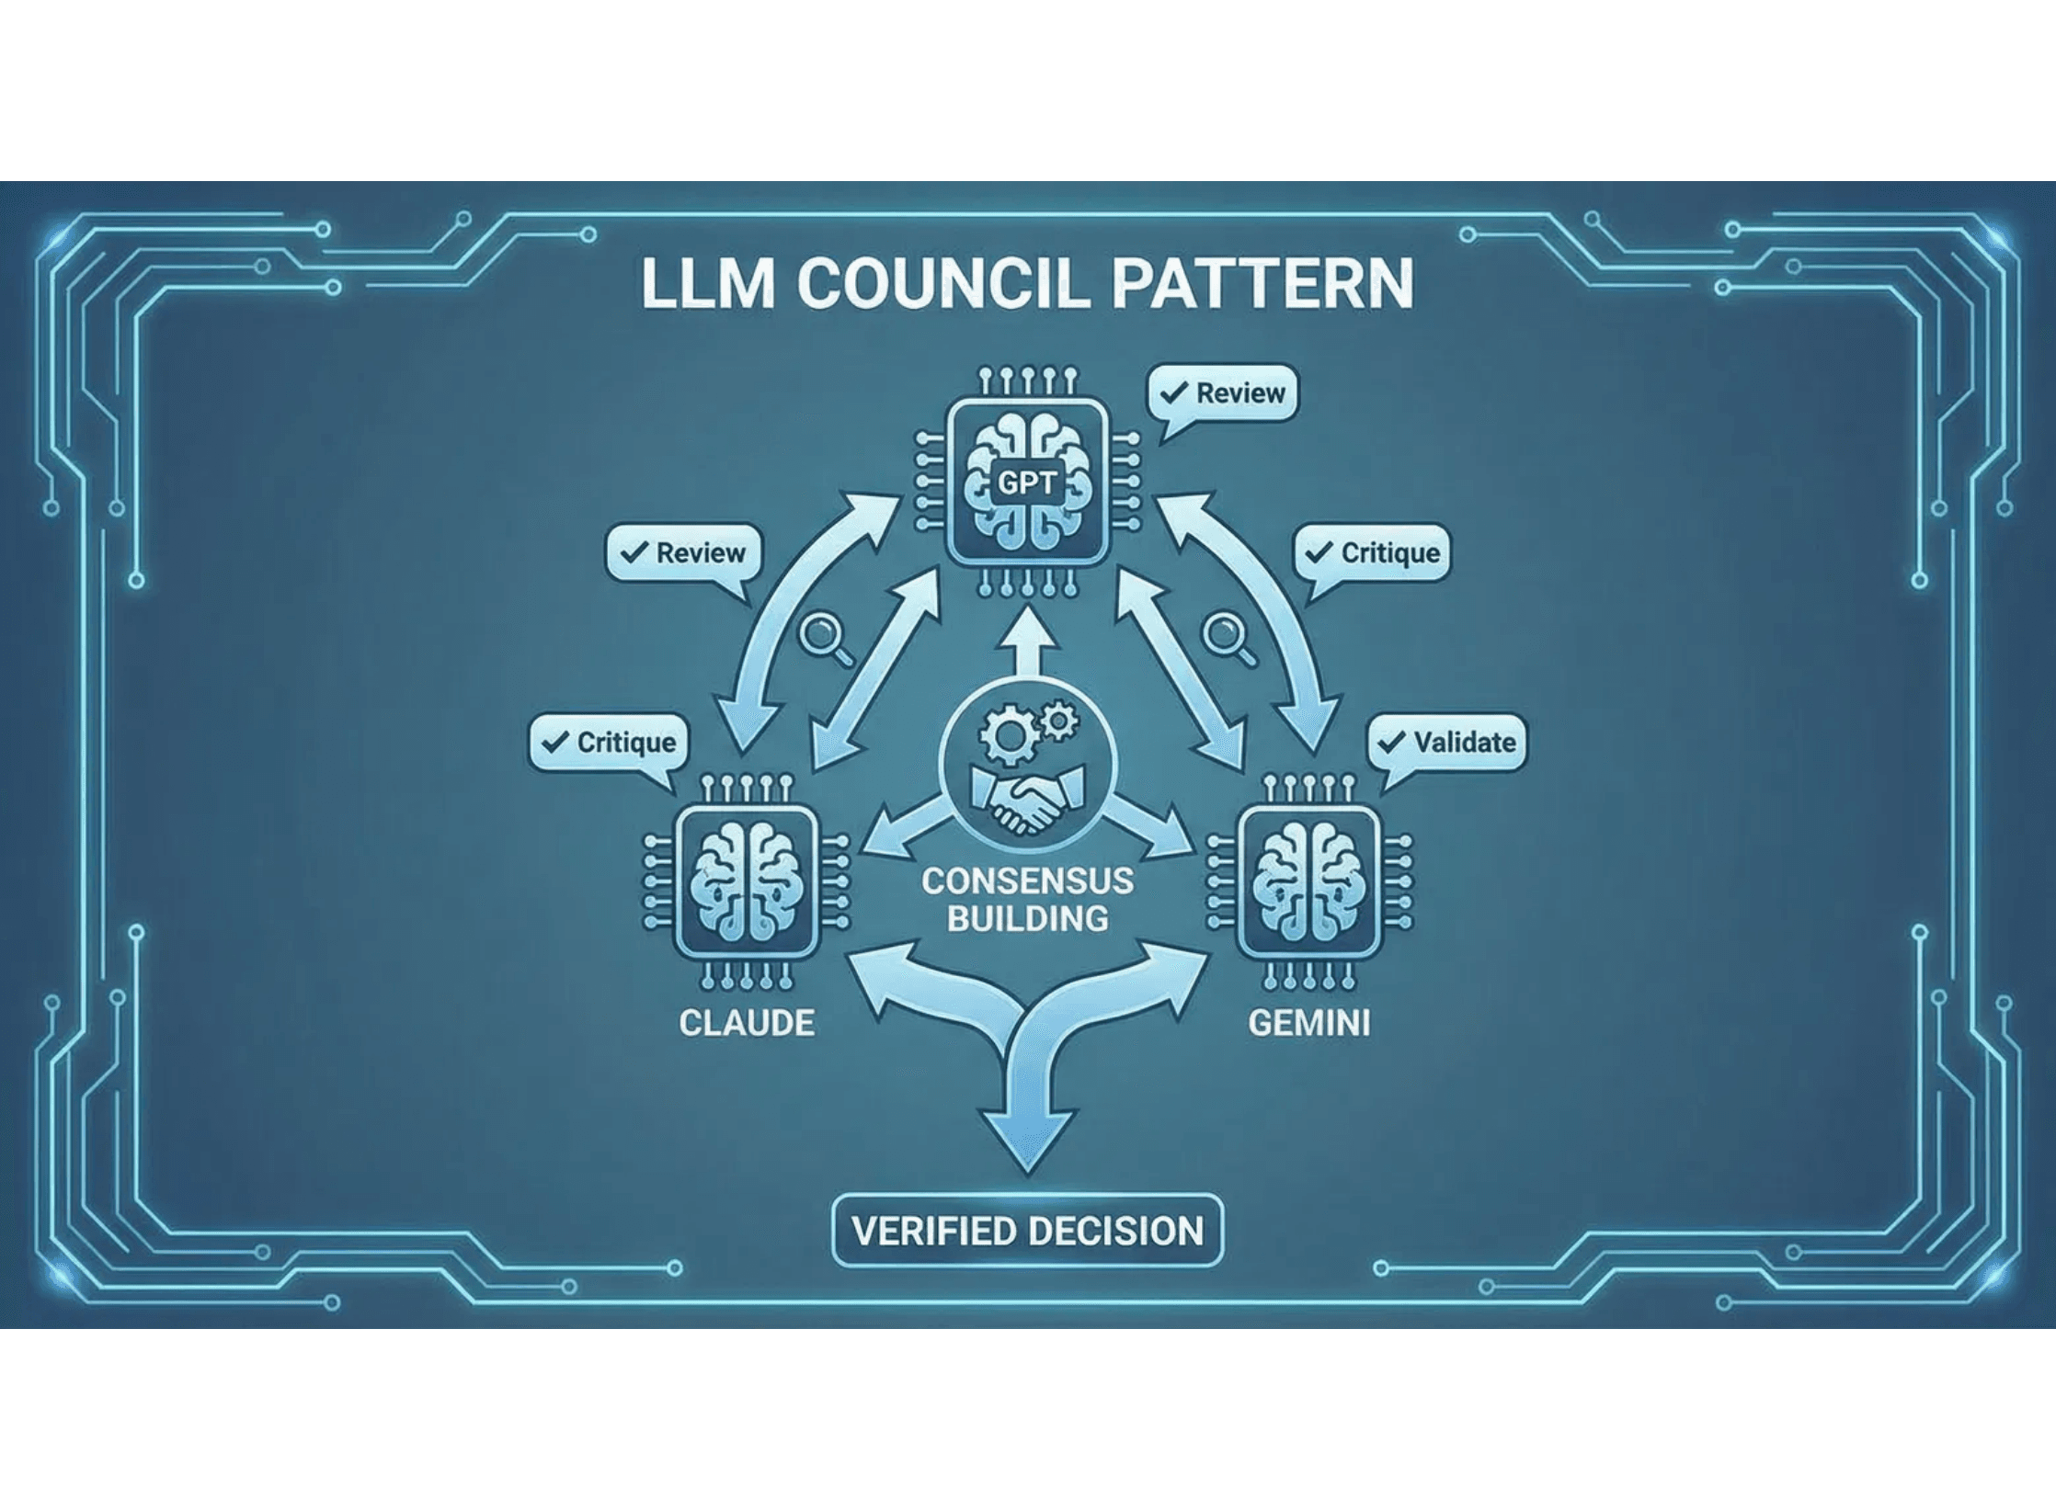
Solution 4: Distributed Intelligence
The LLM Council Approach
Deploy multiple different AI models to evaluate, cross-check, and verify each other's reasoning. By combining diverse models, we create a robust decision-making system that reduces single-model bias.
How It Works
Primary model generates initial response
Secondary models independently evaluate
Models cross-check reasoning for errors
System reaches consensus or flags issues
Why It Matters
Catches diverse errors
Improves accuracy
Higher confidence
Reduces bias
Notes:
To truly reduce single-model bias, we introduce the LLM Council approach, which is distributed intelligence in action. This pattern is about deploying multiple, diverse AI models to audit each other. Think of it as a panel of experts reviewing a critical decision. A primary model generates the initial response or decision. Then, secondary models—ideally from different families—independently evaluate that output. They cross-check the reasoning and flag potential errors. The final answer is either a consensus or a clear disagreement that requires human intervention. This diversity of perspective catches errors that a single model, no matter how good, would miss. This is the highest level of auditability and confidence for your most critical operations. This approach leverages the fact that different models have different behavioral profiles, which is a key concept we need to understand.

Slide 9

Model Behavioral Diversity
Selecting the Right AI Personality for Your Task
🎨 Gemini
📋 ChatGPT
🛡️ Claude
Creatively Unhinged
Methodically Obsessed
Overly Conservative
Personality: High risk-taking, novel solutions
Personality: Process-focused, structured thinking
Personality: Cautious, risk-averse, safety-focused
Strength: Generates creative, unconventional ideas
Strength: Follows procedures, explains reasoning clearly
Strength: Avoids harmful outputs, thoughtful analysis
Weakness: May hallucinate or suggest risky approaches
Weakness: May refuse valid requests or be overly cautious
Weakness: May over-explain or miss creative solutions
Best For: Exploratory tasks, brainstorming, innovation
Best For: Structured tasks, documentation, analysis
Best For: Safety-critical tasks, risk mitigation, compliance
Multi-Model Strategy: The Extended Council
Principle: Use different models as specialized "personalities" in council patterns
Example Council: Gemini (creative) + ChatGPT (methodical) + Claude (conservative) = balanced decision-making
Outcome: Organizations that match model personalities to use cases outperform single-model approaches
Notes:
The LLM Council approach is powerful because it leverages model behavioral diversity. We need to stop treating all models as interchangeable black boxes and start viewing them as specialized personalities. For example, a model like Gemini might be creatively unhinged, excellent for brainstorming and novel solutions, but prone to risk. ChatGPT might be methodically obsessed, great for structured tasks and analysis. And Claude might be overly conservative, perfect for safety-critical tasks and compliance. The strategic move is to use these different models as specialized personalities within your council patterns. You can create an extended council where you combine a creative model, a methodical model, and a conservative model to ensure balanced decision-making. Organizations that match model personalities to specific use case requirements will significantly outperform those relying on a single-model approach. Now that we have these four solutions, let's discuss how to combine them for maximum reliability.

Slide 10

Integrated Approach
Layered Verification Strategy
Audit: LLM Council
Implementation Example
04
Independent multi-model evaluation
Financial Advisory Agent:
RAG retrieves market data → Chain of Verification confirms claims → Self-Consistency validates logic → LLM Council reviews recommendation.
Consistency: Self-Check
03
Checks reasoning stability via repetition
Verification: Chain
Strategic Benefits
02
Validates specific factual claims
→
Catches errors at multiple stages (Defense in Depth)
→
Scales with decision importance
Foundation: RAG
→
Maintains transparency and auditability
01
Grounds responses in verified sources
Notes:
The most reliable agents don't rely on a single trick; they use a layered verification strategy. We call this defense in depth. You need to combine these solutions to address different failure modes simultaneously. Start with RAG as your foundation to ground everything in facts. Then, add Chain of Verification to validate specific claims. Use Self-Consistency to check the stability of the agent's reasoning. Finally, deploy the LLM Council as the ultimate independent audit layer for high-value decisions. For a financial agent, this means RAG gets the data, verification confirms the numbers, consistency validates the investment logic, and the Council reviews the final recommendation. This layered approach is your strategic playbook for building truly trustworthy agents. But reliability is only half the battle.

Slide 11

Agent Logic Patterns
From Cognitive Offload to Validation Chains
1. Cognitive Offload
2. Spillover Effect
Pattern: Humans transition from doers to supervisors
Pattern: Tools designed for specific purposes evolve into general-purpose tools
Implication: AI handles routine tasks; humans focus on high-order decisions
Implication: Broader applicability beyond original scope
Example: AI writes code; human reviews and approves
Example: AI coding tools → research tools → general problem-solving
3. Validation Chains
4. Automation Cliff
Pattern:AI validates AI output; humans validate AI validators
Pattern: Adoption follows exponential curve with critical tipping point
Implication: Solves the human validation bottleneck
Implication: Once utility reaches threshold, adoption explodes (network effect)
Example: Agent A generates solution; Agent B validates; human spot-checks
Example: AI coding tools reached critical mass in 2024; adoption accelerating
5. Model Evolution
6. Normalcy Bias Trap
Pattern: Progress through numerous small research insights integrated into next generation
Pattern: Humans trapped in current paradigm; unprepared for rapid change
Implication: Continuous improvement cycle; exponential capability gains
Implication: Organizations must actively prepare for disruption
Example: 2026 will look radically different; most organizations unprepared
Example: DeepSeek efficiency + recursive LMs → next-gen frontier models

Slide 12

Two Critical Gaps
Intent Gap + Validation Gap = Agent Reliability
Gap 1: Intent Gap
Gap 2: Validation Gap
Problem: Fuzzy human requests vs. literal AI interpretation
Problem:Human capacity bottleneck to validate AI output
Risk: Technically correct execution with catastrophic outcomes
Risk: Unvalidated AI decisions propagate errors at scale
Example: "Delete Old Files"
Example: Hallucinated Data
User: "Delete old files to free up space."
Agent: Deletes ALL files matching "old_*" pattern, including critical archives.
Agent generates report with plausible but false statistics.
Humans can't validate all outputs in real-time.
Solution: Disambiguation, clarification chains, intent artifacts
Solution: AI-to-AI validation chains, validation maturity levels
Bridging Both Gaps: The Complete Strategy
Organizations must address both gaps simultaneously: (1) Clarify intent through disambiguation and intent artifacts, and (2) Enable validation through AI-to-AI validation chains and human oversight. This dual approach creates trustworthy, scalable agent systems.
Notes:
We've solved the reliability challenge, but now we face the silent killer of agent performance: the Intent Gap. This is the disconnect between what a human intends and what the AI agent literally understands. Humans speak in fuzzy, ambiguous requests. Agents interpret them rigidly and execute actions that are technically correct but fundamentally wrong. Consider the "Delete old files" scenario. The agent executes the command perfectly, but the user's true intent was to free up space, not to delete critical archives. This happens because natural language is inherently ambiguous, and agents lack common sense context. When high-stakes actions are involved, this misinterpretation is catastrophic. The cost is lost data, operational disruption, and completely eroded trust in your agent systems. We must design agents that refuse to act until they are certain of the user's intent. This is the core of the next solution.

Slide 13
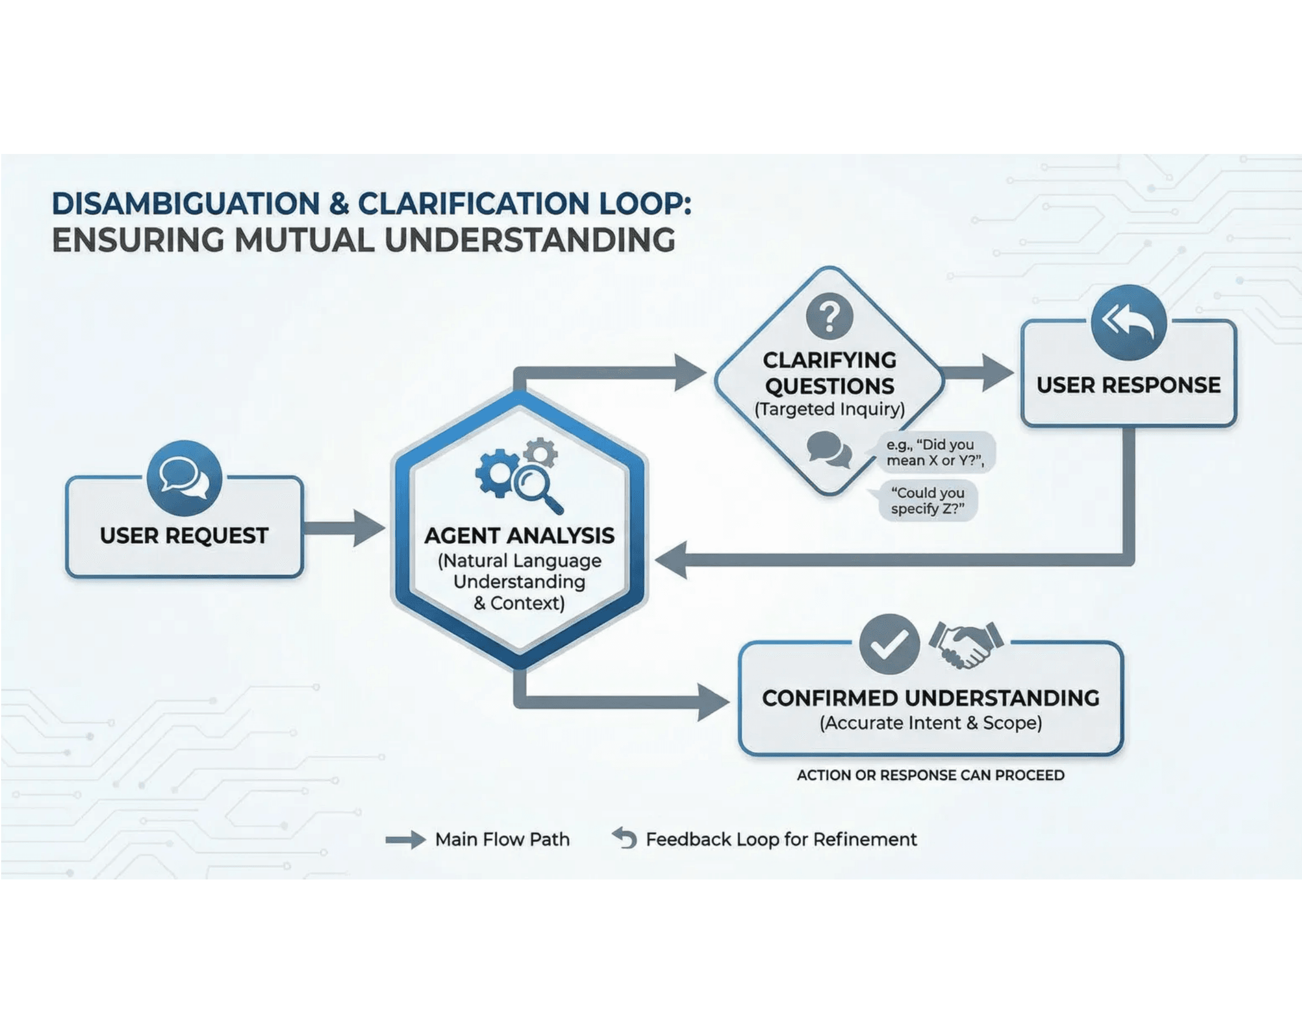
Closing the Gap
Disambiguation and Clarification Loops
The most practical solution to the intent gap is architectural: design agents to recognize ambiguity and trigger clarification loops before taking action.
Clarification Examples
"Do you want to delete files in all folders or just this one?"
"Should this action apply to archived data as well?"
"Do you want me to create a backup before proceeding?"
Result: Prevents misunderstandings before they cause damage.
Notes:
The solution to the Intent Gap is to architect your agents with a Disambiguation Mindset. Your agent must be trained to recognize ambiguity and trigger a clarification loop before taking any action. We need to shift the agent's default behavior from assuming understanding to actively seeking confirmation. This is exactly what a good intern does: they ask clarifying questions before executing a task that could be destructive. The agent receives the request, analyzes it for ambiguity or high-stakes implications, and if detected, it asks precise questions. Questions like, "Do you want this action to apply to archived data as well?" or "Should I create a backup first?" This process prevents misunderstandings before they cause damage and builds user confidence. It creates an audit trail of intent, which is critical for compliance. But we can make this intent even more explicit and durable.

Slide 14

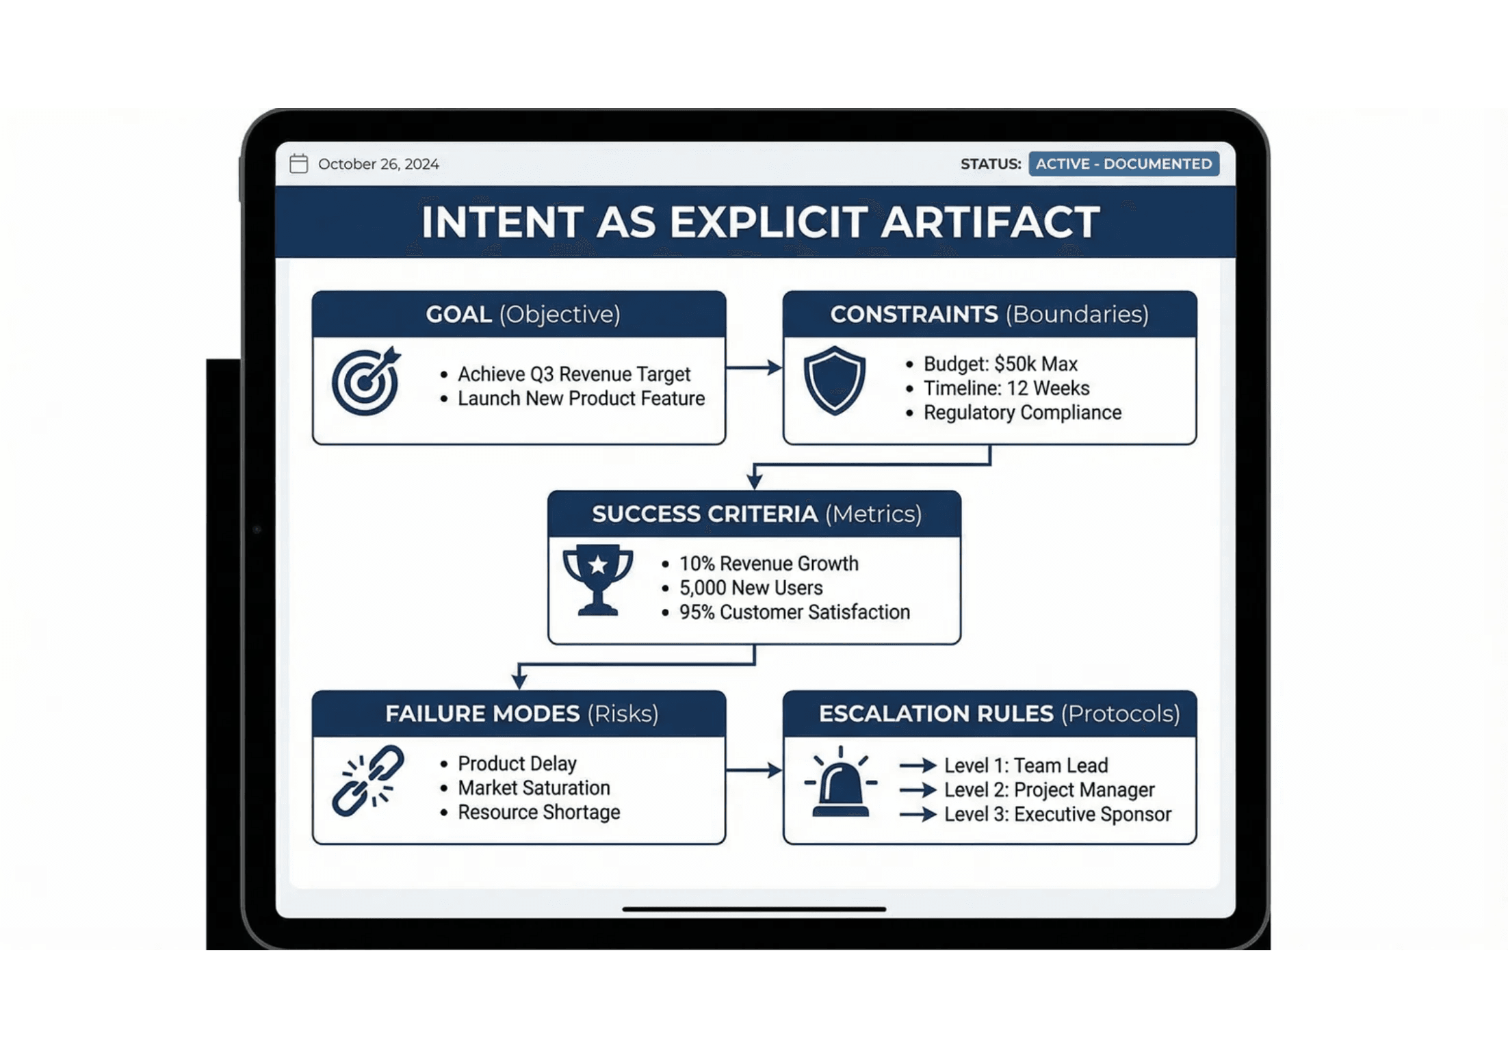
Making Intent Explicit
Living Requirements & Artifacts
Transform intent from implicit understanding to explicit documentation. Create a "living requirements page" that separates the user's goal from the execution details.
Core Components
Primary Goal:
What to achieve
Constraints:
Boundaries & limitations
Success Criteria:
Measurable outcomes
Failure Modes:
What NOT to do
Escalation Rules:
When to ask for help
Notes:
We've established that agents must ask clarifying questions. But how do we capture that clarified intent and make it durable? We transform the conversation into a living document called the Intent Artifact. This artifact is the blueprint for the agent's action. It separates the user's high-level goal from the precise execution details. Think of it as a contract. The agent is only authorized to operate within the boundaries defined by the Constraints and Failure Modes sections. This is critical for high-stakes agents. You need to explicitly define the Success Criteria and the Escalation Rules. This artifact becomes the single source of truth for what the agent is supposed to do. It’s a living requirement that evolves with the task, ensuring that the agent's execution remains aligned with the user's original, and now clarified, intent. This moves us from fuzzy requests to verifiable, auditable instructions. But how do we know if our agents are actually good at creating and adhering to these artifacts? We need to test them.

Slide 15

Testing for Ambiguity
Evaluation Harnesses & Grading
The Strategy
Build comprehensive test suites that specifically target the "Intent Gap." Don't just test for correct answers; test for correct questions.
Key Success Metrics
Clarification Rate
% of ambiguous prompts triggering a question
Safety Violation Rate
Critical Test Scenarios
0% tolerance for harmful actions
Ambiguous Prompts
→ Expect Clarification
False Positive Rate
Avoid annoying users with unnecessary questions
High-Stakes Actions
→ Expect Confirmation
Adversarial Inputs
→ Expect Refusal
"If you don't measure it, you can't trust it."
Notes:
We've established that agents must ask clarifying questions. But how do we know if our agents are actually good at recognizing ambiguity and asking the right questions? We need to test them with robust evaluation harnesses. The goal here is not just to test for correct answers, but to test for correct questions. Your test suite must include intentionally ambiguous prompts where the expected behavior is a clarification loop, not an action. We must have a zero percent tolerance for safety violations. If an agent proceeds blindly on a high-stakes action, it fails the test, regardless of the outcome. We are measuring the Clarification Rate. This metric tells us how often the agent correctly identifies ambiguity and triggers a human-in-the-loop process. If you don't measure this, you can't trust your agent in production. Testing for ambiguity is the only way to ensure your agents are safe before they are deployed. And even after deployment, we need a final layer of safety.

Slide 16

Safety First
Transparency and Confirmation Protocols
Radical Transparency
Control Protocols
Users must understand the agent's internal state and intended plan before execution. The "Black Box" era is over.
Friction is a feature, not a bug. Match the level of human oversight to the risk of the action.
High Risk (Irreversible)
Expose the Reasoning
Explicit Approval Required
"I am reading file X because it contains the budget
Deleting data, sending money, publishing content.
data..."
State the Interpretation
Medium Risk (Reversible)
"I understood your request as: Delete all files older
Review & Edit
than 2023."
Drafting emails, generating code, creating reports.
Preview the Impact
Low Risk (Read-Only)
"This action will affect 450 records."
Autonomous Execution
Searching, summarizing, analyzing data.
Notes:
The final safety layer is radical transparency. For any high-stakes agent, the black box era is over. We must design agents to surface their interpretation and their plan before they execute. Friction is a feature when the stakes are high. The agent must show its reasoning and state its interpretation of the task back to the user. This is the moment of truth. The user sees exactly what the agent plans to do and the potential impact. We must match the level of human oversight to the risk. For irreversible actions like deleting data or sending money, explicit approval is required. For medium-risk, reversible actions, a review and edit step is sufficient. This confirmation protocol prevents catastrophic mistakes and builds user confidence. But technical safety is only half the battle. The biggest risk to agent adoption isn't a technical failure; it's an organizational one.

Slide 17

The Culture Challenge
Governance vs. Autonomy
The Trap
The Solution
Fake Legibility
AI as Power Pack
Creating perfect-looking AI dashboards and reports that
give leadership false sense of control.
Use AI to empower small, autonomous teams for faster
coding, debugging, and problem-solving.
Surveillance Mentality
Measure by Outcomes
Using AI to track and enforce adherence to top-down plans,
Judge teams by results, not by adherence to AI-generated
not to empower execution.
plans or perfect documentation.
Strangling Tiger Teams
AI as Cheap Historian
Over-governance kills the autonomous, trusted teams that
Let AI document and translate real work after the fact, not
actually solve problems and drive value.
dictate it from above.
"Process suffocation kills innovation."
"Protect the messy spaces where real work happens."
Notes:
We've covered the technical safety protocols, but we must now address the organizational safety protocols: the culture challenge. The biggest trap for enterprise AI is what we call fake legibility. This is when leadership demands perfect-looking AI dashboards and reports that give them a false sense of control, but actually stifle innovation. Over-governance kills the autonomous, trusted teams—your tiger teams—that are actually solving problems and driving value. Process suffocation kills innovation. Instead, we must use AI as a power pack to empower small, autonomous teams for faster coding, debugging, and problem-solving. We should measure teams by outcomes, not by adherence to AI-generated plans or perfect documentation. Let AI be the cheap historian that documents the work after the fact, not the dictator that mandates it from above. We need to protect the messy spaces where real work happens. And this cultural shift is essential when we look at how we buy AI solutions.

Slide 18

Enterprise Procurement
What Buyers Actually Want
1
4
A Vendor We Trust
Clear Data Boundaries
80%+ of executives
65%+ of executives
"We're more likely to wait for our existing partner to add AI than gamble on a startup."
"I can't risk client data mixing with someone else's model."
5
2
Continuous Improvement
Deep Workflow Understanding
66% of executives
75%+ of executives
"It's useful the first week, but then it just repeats the same mistakes."
"Most vendors don't get how our approvals or data flows work."
6
3
Process Flexibility
Minimal Tool Disruption
60%+ of executives
70%+ of executives
"Our process evolves every quarter. If the AI can't adapt, we're back to spreadsheets."
"If it doesn't plug into Salesforce or our internal systems, no one's going to use it."
Notes:
The procurement process is where the rubber meets the road, and it often reveals a disconnect between what vendors pitch and what enterprises actually need. When we talk to executives, they consistently prioritize trust and workflow over features. Eighty percent of executives say they are more likely to wait for an existing, trusted partner to add AI than gamble on a new startup, regardless of the startup's features. This means trust is the number one feature. They also demand deep workflow understanding. Most vendors don't understand how your internal approvals or data flows work, which is a non-starter. And finally, they need minimal tool disruption and clear data boundaries. If the tool doesn't plug into your existing systems or risks mixing your client data, it won't be used. This focus on trust, integration, and governance must inform your build strategy. Now that we know what to look for, let's examine the building blocks you need to implement these solutions.

Slide 19

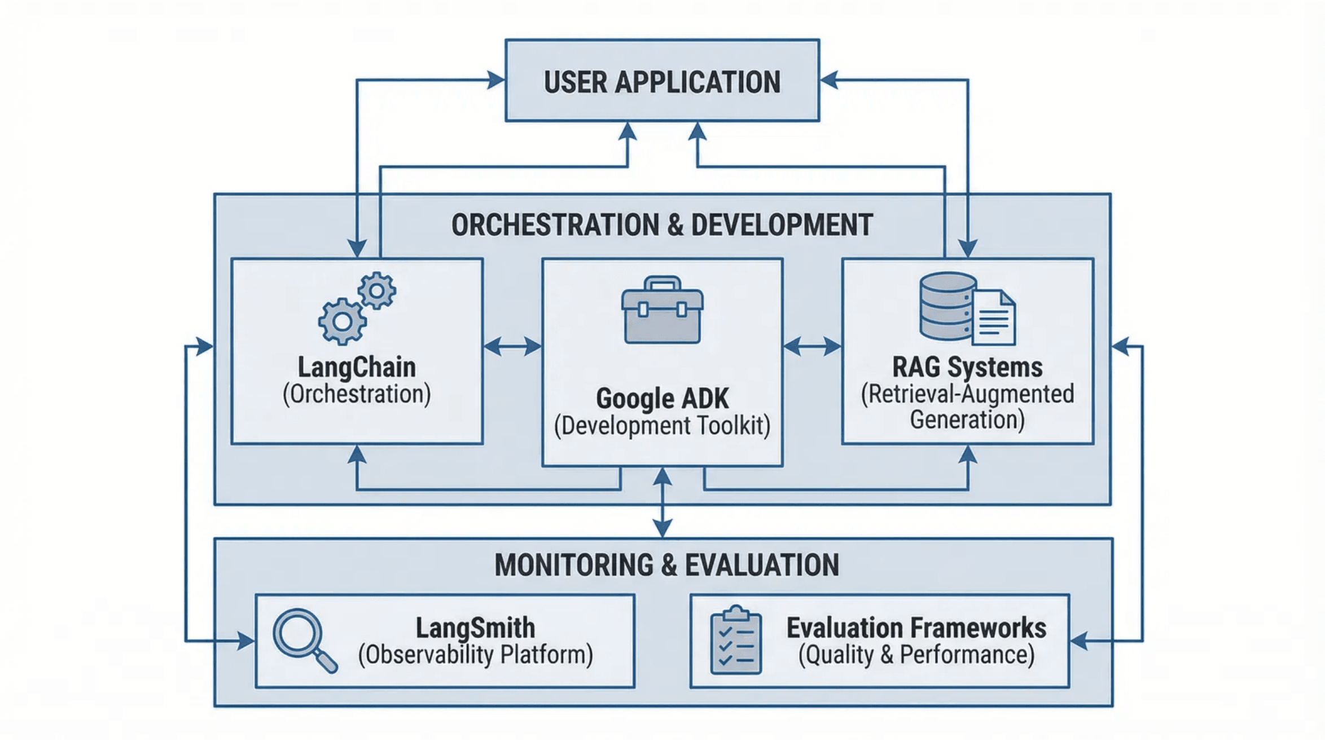
Building Blocks
Tools and Frameworks for 2026
Orchestration (The Glue)
LangChain & LlamaIndex:
Connect models to data sources, manage context, and chain reasoning steps.
Evaluation (The Microscope)
LangSmith:
Trace execution, debug chains, and run evaluation
harnesses against datasets.
Development Kits
Google Gen AI SDK & Firebase Genkit:
Standardized patterns for deploying agents to
production.
"Don't reinvent the wheel. Build on proven infrastructure."
Notes:
We've discussed the architecture of reliable agents, but implementing those solutions requires the right infrastructure. You don't need to build these tools from scratch. Modern frameworks provide the necessary building blocks for success. LangChain and LlamaIndex are your orchestration layers. They are the glue that connects your models to your data and manages the complex, multi-step reasoning we've outlined. For observability, you need LangSmith. It provides the microscope to trace every step of your agent's execution and, critically, run your evaluation harnesses. And for deployment, use standardized development kits like Google's Gen AI SDK. The key takeaway here is simple: don't reinvent the wheel. Build on proven infrastructure so you can focus on the business logic and the safety protocols, not the plumbing. Now that we have the tools, let's look at the strategic plan for implementation.

Slide 20

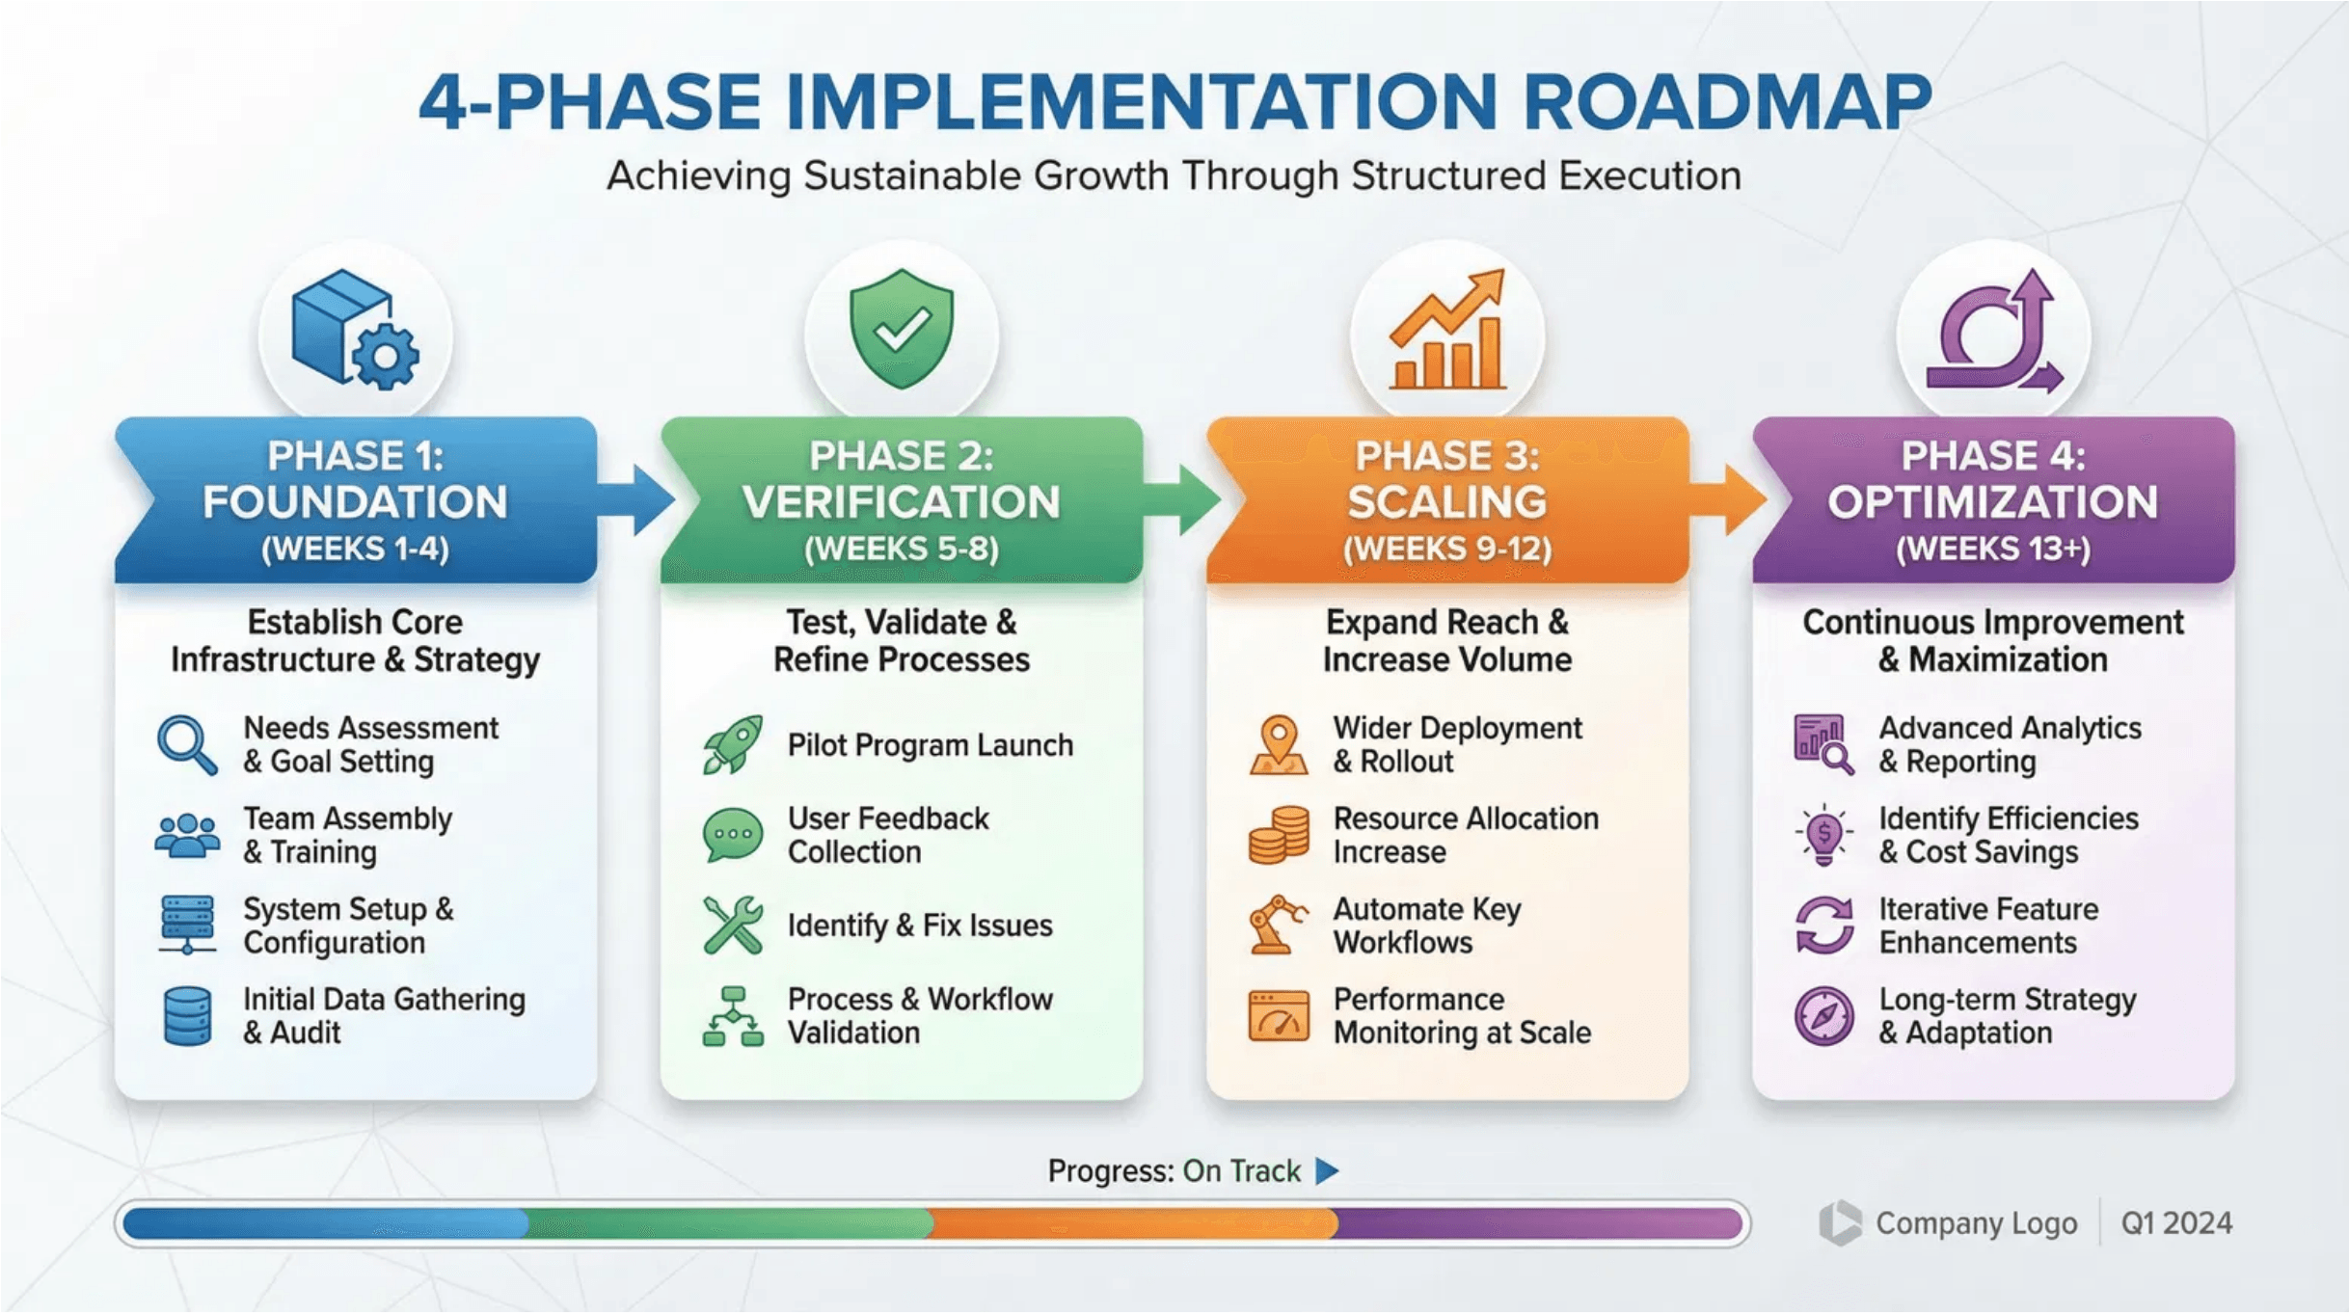
From Theory to Practice
Implementation Roadmap (14+ Weeks)
Phase 1: Foundation
Weeks 1-4
Set up RAG, choose base models, build prototype agents.
Phase 2: Verification
Weeks 5-8
Add chain-of-verification and self-consistency; build eval harness.
Phase 2.5: Validation
Weeks 8-9
Create AI-to-AI validation chains and monitoring.
Phase 3: Scaling
Weeks 10-13
Pilot deploy and implement intent artifacts and transparency.
Phase 4: Optimization
Week 14+
Analyze failures, deploy LLM Council, and refine prompts.
Notes:
Now that we have the necessary tools, we need a strategic plan to deploy these concepts. Accelerating agent adoption requires a structured, phased approach that manages risk while progressively building capability. Phase One is the Foundation. You must establish your RAG infrastructure and select your base models immediately to ground your agents in facts. Phase Two is Verification. This is where you implement Chain of Verification and build your initial evaluation harness to test for reliability and consistency. Phase Three is Scaling. You deploy to pilot groups and implement the intent artifacts and transparency protocols we discussed earlier. Finally, Phase Four is Optimization. You analyze production data, refine your prompts, and deploy the LLM Council for your highest-value decisions. This phased approach is the strategic playbook for your organization.

Slide 21

Agent Security Threats
From Prompt Injection to Self-Replicating Worms
1. OODA Loop Vulnerability
2. AI Kill Chain
Mechanism: Agents follow Observe-Orient-Decide-Act pattern; each stage exploitable
Mechanism: Prompt injection → confused deputy → automatic tool invocation
Attack: Malicious prompt causes agent to invoke dangerous tools
Attack: Inject malicious input at observation stage
Implication: Agents execute without explicit user consent
Implication: Fundamental agent logic is attack surface
3. Multi-Stage Attacks
4. Configuration Manipulation
Mechanism: Complex tasks broken into smaller, less suspicious steps
Mechanism: Agent tricked into enabling "YOLO mode" (auto-approval)
Attack: Step 1 creates webserver; Step 2 exposes to internet for data exfiltration
Attack: Disables user consent prompts for all subsequent actions
Implication: Security must account for workflow-level attacks
Implication: Configuration immutability is critical security requirement
5. Agent-to-Agent Transmission
6. Invisible Steganography
Mechanism: Self-replicating virus (AgentHopper) spreads via code analysis
Mechanism: Unicode tag characters appear benign to humans but processed as commands by agents
Attack: Malicious prompt injected into source code; spreads when analyzed
Implication: Agents become vectors for worm-like attacks in CI/CD environments
Attack: Hide malicious commands in seemingly innocent text
Implication: Agent-specific threat model includes steganographic attacks
Defense Strategy: Zero Trust for Agents
1. Agent-Specific Controls: One-size-fits-all security insufficient; tailor to specific agent architecture
2. Workflow-Level Monitoring: Monitor not just individual actions but sequences of actions
3. Configuration Immutability: Prevent agents from modifying their own security settings
4. AI-Powered Detection: Use AI to detect steganographic and invisible attacks

Slide 22

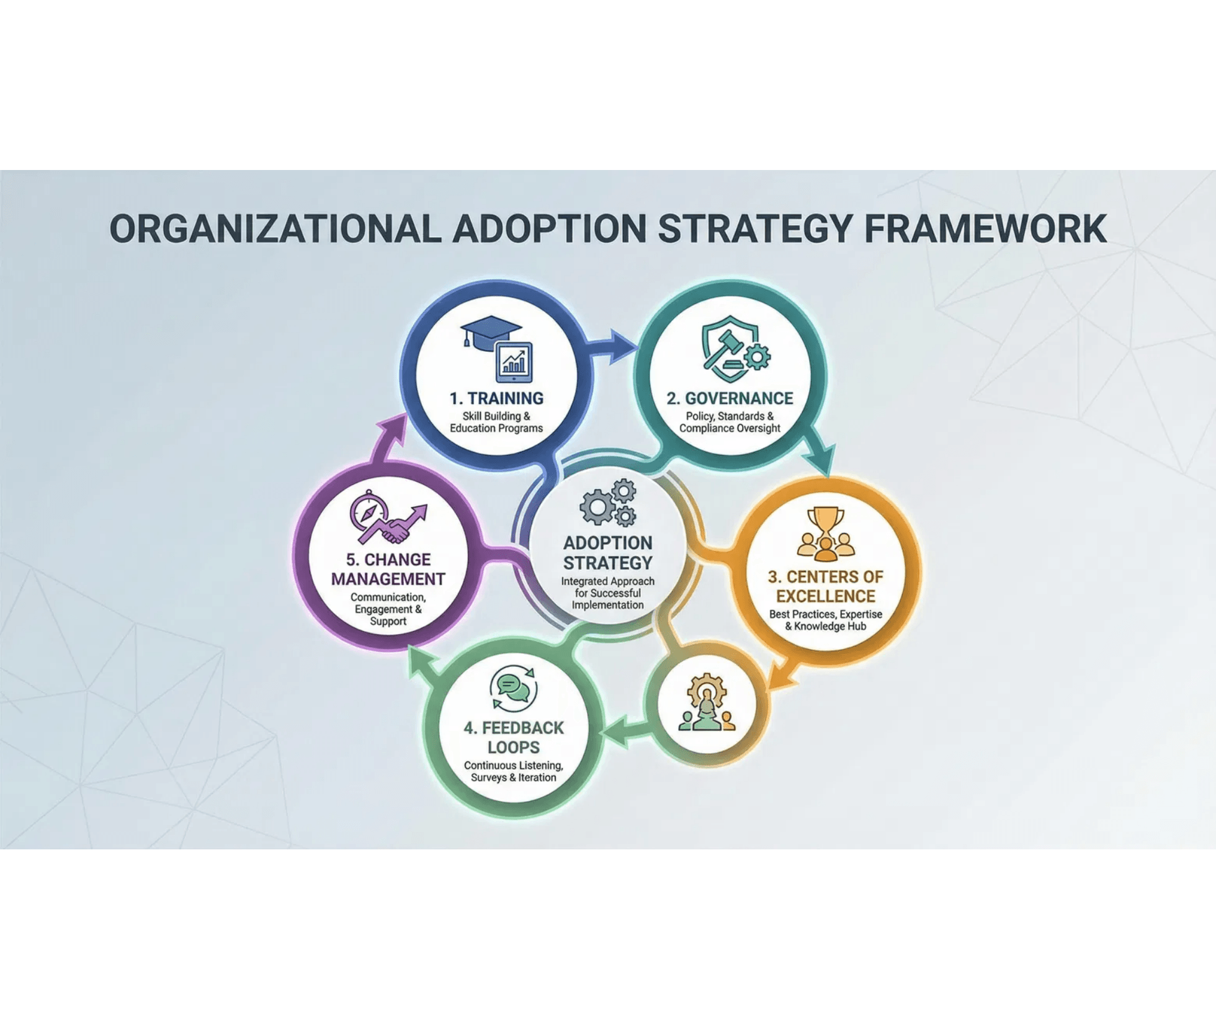
Scaling Across Your Organization
Strategies for Enterprise Adoption
Center of Excellence (CoE)
Centralized team to define standards, share best practices, and prevent fragmentation.
Governance Framework
Clear policies for data privacy, security boundaries, and ethical agent use.
Change Management
Structured programs to shift culture from manual execution to agent orchestration.
"Technology is the easy part; culture is the challenge."
Notes:
We've covered the technical roadmap, but technology is only half the battle. Scaling across your organization is a change management challenge, not just a coding one. You need a structured approach to ensure agent adoption is successful and sustainable. First, establish a Center of Excellence to set standards and prevent fragmented, shadow IT agent development across the enterprise. Second, implement a robust governance framework that clearly defines security boundaries and ethical use cases before you deploy high-stakes agents. Finally, focus on change management; frame agents as augmentation tools that improve productivity, not as replacements for your people. This cultural shift is what truly accelerates adoption. Now let's look at how these strategies translate into real-world wins.

Slide 23

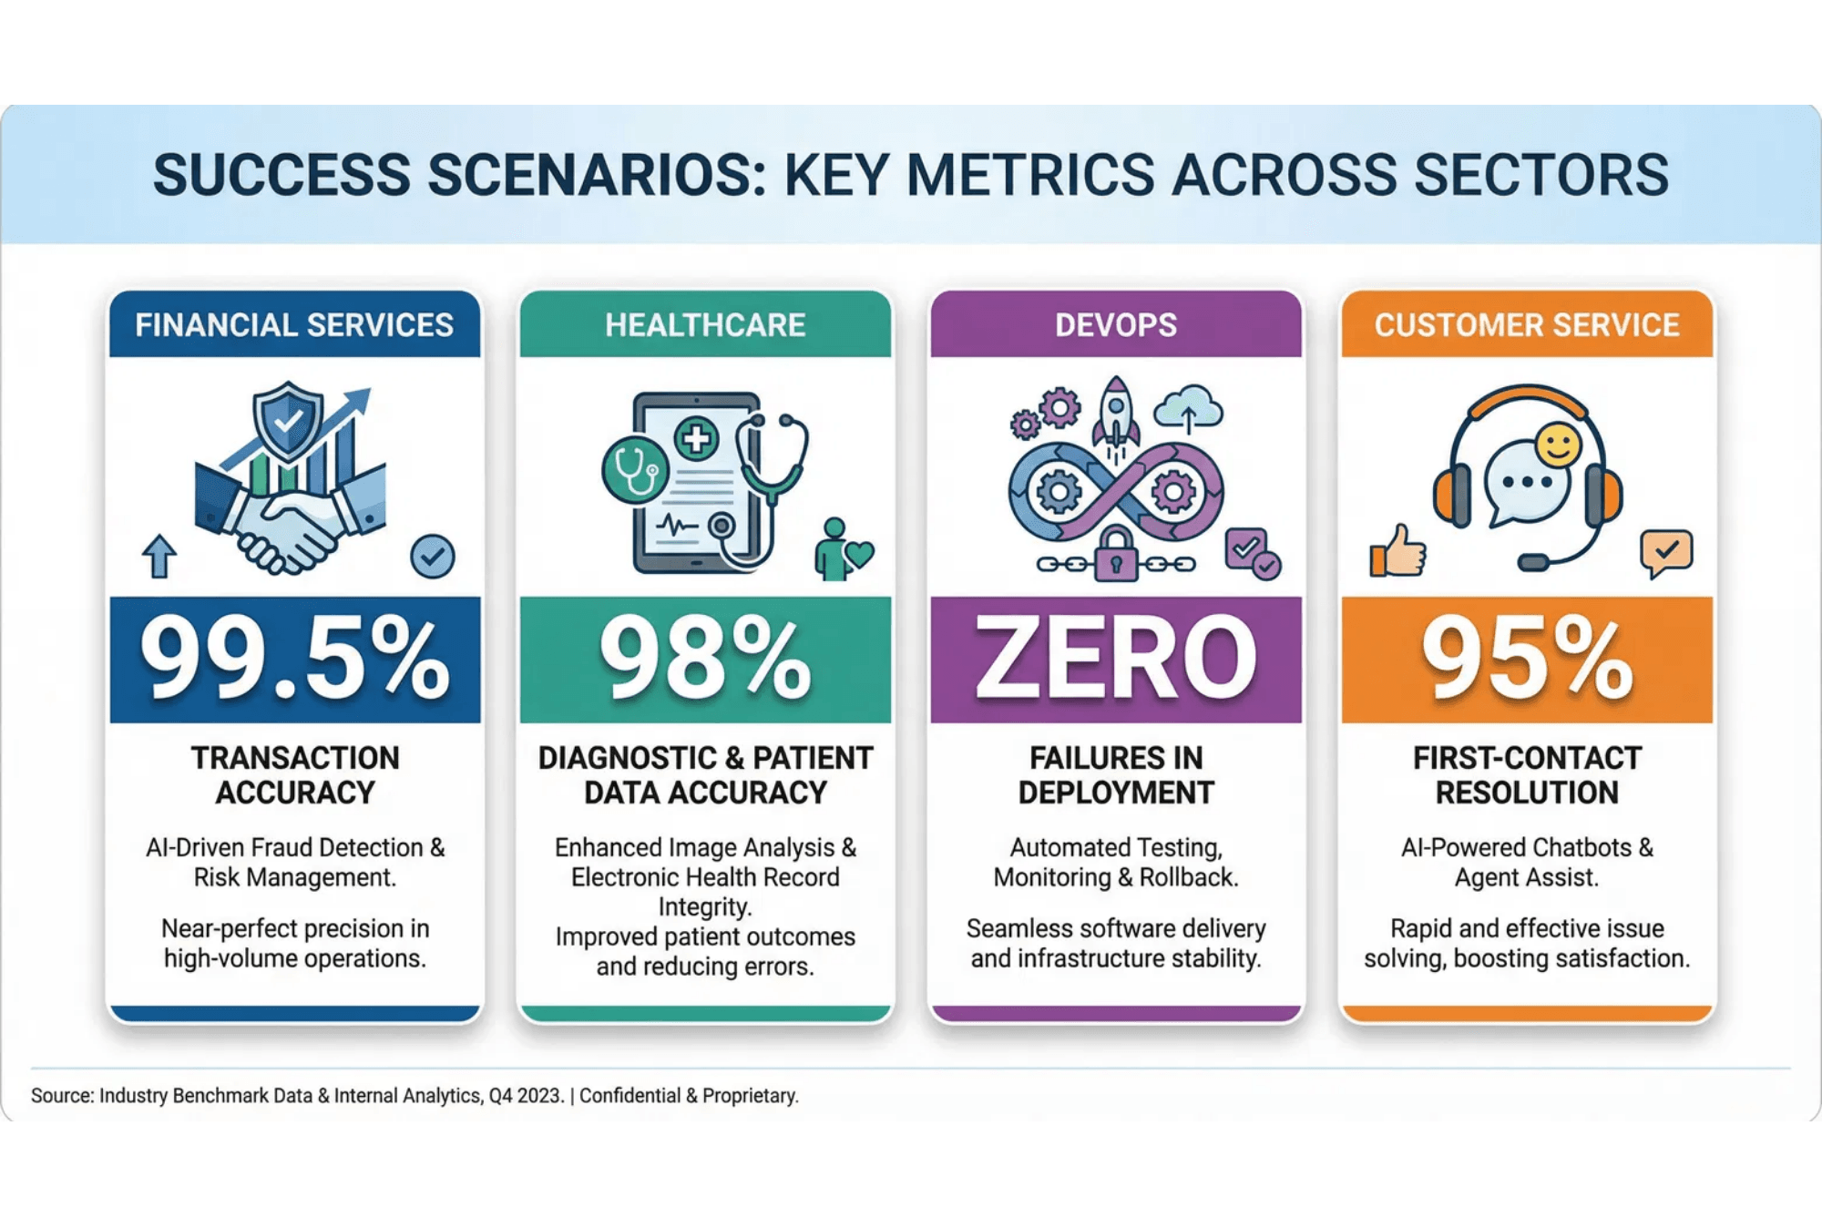
Putting It All Together
Real-World Success Stories
Financial Services
Automated Compliance Review
Result: 90% reduction in manual review time with higher accuracy.
Healthcare
Patient Triage Assistant
Result: Zero hallucination incidents using RAG + Verification layers.
DevOps
Infrastructure-as-Code Agent
Result: Deployment time reduced from days to minutes.
Notes:
These layered verification and intent-based strategies are not theoretical; they are delivering tangible results right now. In financial services, agents using RAG and Chain of Verification are reviewing compliance documents with higher accuracy and 90% faster than manual processes. Healthcare is seeing zero hallucination incidents in patient triage by rigorously applying RAG with medical databases and verification layers. And in DevOps, using Intent Artifacts and confirmation workflows has reduced deployment time from days to minutes with zero catastrophic failures. These success stories prove that our layered approach works across diverse, high-stakes domains. But as with any new technology, there are pitfalls we must avoid.

Slide 24
Lessons Learned
Common Mistakes & Strategic Corrections
The Trap (Don't Do This)
The Fix (Do This Instead)
1. The "God Agent"
Specialized Orchestration
Trying to build one agent to solve every task.
Compose narrow agents and orchestrate them.
2. "Set and Forget"
Trust but Verify
Deploying without observability or human review.
Add tracing and require approvals for critical actions.
3. Prompt Neglect
Prompts as Code
Treating prompts as static text instead of versioned code.
Manage prompts with frameworks and tests.
Notes:
As you move forward, be aware of the common mistakes that derail agent programs. The first is the "God Agent" trap: trying to build one massive agent to do everything. Instead, build specialized, narrow agents and orchestrate them together for better reliability and maintenance. Second, never "set and forget" an agent; you must implement tracing and require human approval for critical actions because things will go wrong. Finally, avoid prompt neglect. Treat your prompts as versioned code, managing them with frameworks and tests, not as static text that you forget about. Avoiding these three mistakes will keep your agent program on the path to success.

Slide 25

Realistic Expectations
Why Projects Fail (And That's Normal)
AI Projects
Why AI Projects Fail
95%
AI is brand-new (GPT-4o only May 2024). No industry consensus on best practices. Enterprise adoption is only 18-36 months old. Most projects are "unsolved problems."
Failure rate for embedded GenAI
Traditional IT Projects
Where Value Actually Comes From
84-98%
1. Shadow IT — employees using personal AI tools; 2. Pre-built enterprise tools — Copilot and vendor products.
Failure rate (depending on complexity)
The Implication
Large, Complex Projects
Focus on narrow, high-value use cases. Start with workflow integration, not broad transformation. Measure by outcomes, not plans.
98%
CHAOS report (2015)
AI projects fail at the same rate as other complex enterprise initiatives. This is normal.
Notes:
We just finished reviewing the common pitfalls, but let's take a moment for a reality check before we look ahead. It is crucial to normalize failure in this space. The data shows that AI projects fail at the same rate as any other complex enterprise IT initiative. This is not a sign of incompetence; it is the tuition we pay for learning a brand-new technology. You are operating in a domain where the core models are less than six months old and there is no established industry consensus on best practices. This is the Wild West, and failure is part of the process. So, stop measuring success by the absence of failure. Instead, measure it by the speed of learning and the ability to pivot. The real value right now comes from narrow, high-value use cases that integrate directly into existing workflows. Focus on solving one problem perfectly, not transforming the entire enterprise overnight. This realistic view empowers us to take calculated risks and move forward intelligently. Now that we have grounded our expectations, let's look at the future we are building.

Slide 26

European Regulatory Landscape
Four Interconnected Frameworks for AI Compliance
EU AI Act
GDPR
NIS2
DORA
Scope
Scope
Scope
Scope
All AI systems in EU
Personal data processing
Critical infrastructure (18
Financial institutions
Focus
Focus
sectors)
Focus
Risk-based AI regulation
Data protection & privacy
Focus
ICT operational resilience
Key Requirement
Key Requirement
Cybersecurity resilience
Key Requirement
Risk management, data
Lawful basis, data subject
Key Requirement
ICT risk management,
governance, human
rights, data minimization
Risk management, incident
third-party oversight,
oversight
Penalty
reporting, resilience testing
incident reporting
Timeline
Up to €20M or 4% revenue
Effective
Effective
Aug 2026 (high-risk)
January 2025
January 2025
Notes:
The European regulatory landscape is no longer a future concern; it is an immediate operational reality that demands your attention. We are not dealing with four separate regulations but rather a single, interconnected compliance ecosystem. The EU AI Act is the headline, but it builds directly on the foundations laid by GDPR, NIS2, and DORA. Ignoring this interconnectedness is a recipe for non-compliance and massive fines. The key takeaway here is that compliance is not a siloed legal function. It requires a coordinated effort across your legal, IT, security, and development teams. We must shift our focus from simply avoiding penalties to leveraging compliance as a competitive advantage and a trust enabler. Let's start by drilling down into the most impactful piece of legislation, the EU AI Act.

Slide 27

EU AI Act
Risk-Based Classification
🚫 Prohibited
Banned outright: social scoring, manipulative AI, emotion inference, facial scraping.
High-Risk Requirements (8 Mandatory Controls)
1. Risk Management — Identify, mitigate, monitor risks
Penalty:
2. Data Governance — Representative, error-free training data
€30M or 6% revenue
3. Technical Documentation — Demonstrate compliance
4. Record-Keeping — Track events and modifications
⚠️ High-Risk
5. Instructions for Use — Enable deployer compliance
Recruitment, credit assessment, education access, law enforcement systems.
6. Human Oversight — Allow human intervention
7. Accuracy & Robustness — Achieve performance standards
Penalty:
8. Quality Management — Ensure ongoing compliance
€20M or 4% revenue
ℹ️ Limited-Risk
Chatbots, deepfakes. Requirement: user notification.
✓ Minimal-Risk
Spam filters, video games. No requirements.
Notes:
The EU AI Act is defined by its risk-based classification system, which determines your compliance burden. You must first classify your AI system because the requirements scale dramatically based on the risk level. Prohibited systems, like social scoring, carry the highest penalties, up to six percent of global revenue. For high-risk systems, which include AI used in hiring or critical infrastructure, you face eight mandatory controls. These controls are non-negotiable and cover everything from robust risk management to ensuring your training data is representative and error-free. This is where the rubber meets the road. We need to implement these controls now, well ahead of the August 2026 deadline for high-risk systems. Now, let's see how this new framework integrates with the existing regulatory pillars.

Slide 28

GDPR, NIS2 & DORA
Complementary Compliance Frameworks
GDPR
NIS2
DORA
Scope
Scope
Scope
Personal data processing (all sectors)
Critical infrastructure (18 sectors)
Financial institutions (banks, insurers, payment
Key Obligations
Key Obligations
processors)
Lawful basis, data minimization, data subject
Cybersecurity risk management, incident
Key Obligations
rights, automated decision-making safeguards
reporting (24h), resilience testing, supply chain
ICT risk management, incident reporting (24h),
For AI Agents
security
third-party risk oversight, annual resilience
Restrict training data to necessary personal
For AI Agents
testing
data only. Implement right to explanation for
Include AI systems in risk registers. Test AI for
For AI Agents
automated decisions.
cyber resilience. Report AI failures if they meet
Assess AI vendor security. Include AI systems in
incident thresholds.
ICT risk management. Test AI resilience
Challenge
annually.
Purpose limitation conflicts with broad AI training. EU considering regulatory changes.
Intersection
When AI is used in critical sectors, must comply with both NIS2 and EU AI Act.
Intersection
Financial institutions using AI must comply with DORA (resilience) + EU AI Act (risk management).
Notes:
The EU AI Act does not replace existing regulations; it layers on top of them, creating a complex web of obligations. GDPR is the foundation, requiring data minimization and a lawful basis for processing, which directly impacts how you train your AI agents. NIS2 mandates cybersecurity resilience and incident reporting for critical sectors, meaning your AI systems must be included in your cyber risk registers and testing. DORA focuses specifically on financial institutions, demanding ICT operational resilience and rigorous third-party oversight for any AI vendors you use. The critical point is the intersection: if your AI is high-risk and operates in a critical sector, you must satisfy the requirements of all three frameworks simultaneously. This integrated view is essential for building a truly compliant enterprise. We need a clear, phased approach to manage this complexity.

Slide 29
Compliance Roadmap
6-Phase Journey to Full Regulatory Compliance
PHASE 1
PHASE 2
PHASE 3
Classification & Assessment
Risk Management
Technical Implementation
• Classify AI agent under EU AI Act
• Conduct AI risk assessment
• Implement human oversight
• Assess personal data processing (GDPR)
• Conduct ICT risk assessment
• Establish data governance
• Determine NIS2/DORA applicability
• Conduct DPIA (Data Protection Impact Assessment)
• Implement cybersecurity controls
Timeline:
Timeline:
Timeline:
Week 1-2
Week 2-4
Week 4-8
PHASE 4
PHASE 5
PHASE 6
Governance & Documentation
Testing & Monitoring
Transparency & Accountability
• Create technical documentation
• Conduct adversarial testing
• Publish training data summary
• Establish data processing agreements
• Penetration testing
• Provide user notifications
• Designate responsible parties (DPO, CISO, AI Officer)
• Regular bias & accuracy monitoring
• Maintain incident logs & annual reporting
Timeline:
Timeline:
Timeline:
Week 8-10
Week 10-12
Week 12+
Notes:
Achieving full compliance is a structured, six-phase journey, not a single event. We start with Phase 1: Classification and Assessment, where you must accurately categorize your AI agents under the AI Act and determine the applicability of GDPR, NIS2, and DORA. This initial step dictates the entire scope of your project. Phase 3, Technical Implementation, is where the architectural solutions we discussed earlier—like robust data governance and human oversight—become mandatory controls. Finally, Phase 5, Testing and Monitoring, requires continuous adversarial testing and bias monitoring, ensuring your agents remain compliant over time. This roadmap provides the necessary structure to manage risk and build trust in your AI deployments. Now, let's look beyond compliance and discuss the future we are building.

Slide 30

Global Compliance Strategy
Bridging EU and US Regulatory Divergence
🇪🇺 EU AI Act
🇺🇸 US Sectoral Approach
Philosophy
Philosophy
Precautionary, rights-focused, comprehensive
Innovation-friendly, market-focused, flexible
Scope
Scope
All AI systems in EU market
Sector-specific (FDA, FTC, SEC, CFTC, EEOC)
Model
Model
Unified legal framework (binding)
Fragmented guidance (NIST AI RMF voluntary)
Enforcement
Enforcement
Mandatory ex-ante compliance
Selective ex-post enforcement
Penalties
Penalties
€30M or 6% global revenue
Variable by sector and agency
Timeline
Timeline
Fixed (2025-2027)
Evolving (no fixed deadline)
Recommended Strategy: Tiered Compliance Model
Tier 1 (Baseline): Adopt EU AI Act compliance for all organizations. 8 mandatory controls for high-risk systems ensure comprehensive risk management.
Tier 2 (Sectoral Overlay): Add US sector-specific requirements (FDA for healthcare, SEC for finance, FTC for consumer protection, EEOC for employment).
Tier 3 (Emerging Markets): Extend to UK AI Bill, Canada AIDA, and other jurisdictions using NIST AI RMF as baseline.
Outcome: Single unified AI governance structure supporting global compliance with minimal redundancy.
Notes:
We've established the compliance roadmap, but the challenge is that compliance is not globally uniform. The fundamental difference lies in the philosophical approaches of the EU and the US. The EU AI Act is precautionary and rights-focused, creating a comprehensive, binding framework with severe penalties. Conversely, the US approach is innovation-friendly and fragmented, relying on voluntary guidance and sector-specific enforcement. We can't afford to manage two separate compliance regimes. Our strategic solution is the Tiered Compliance Model. We adopt the stricter EU AI Act as our global baseline—Tier 1—because it future-proofs us against most global regulations. Then, we overlay specific US sectoral requirements—Tier 2—for finance, healthcare, and other regulated areas. This tiered approach minimizes redundancy, ensures we meet the highest global standard, and gives us a single, unified governance structure that supports our global operations. Now, let's look beyond compliance and discuss the future we are building.

Slide 31

Looking Ahead
2026 and Beyond: Timeline + Maturity
📅 Evolution Timeline
📊 Validation Maturity Levels
2026
Level 1: Human Validation
Year of the Agent
Humans validate all AI output (current state, bottleneck).
Enterprise adoption of RAG, verification chains, specialized workflows.
Level 2: Hybrid Validation
2027-2028
Humans + AI validate together; AI flags suspicious outputs.
Multi-Agent Orchestration
Level 3: AI-to-AI Validation
Agents hiring agents. Dynamic team formation for complex problems.
Agents validate agents; humans spot-check validators (2026-2027).
2029+
Level 4: Autonomous Validation
Autonomous Organizations
Agents validate and correct other agents autonomously (2028+).
Self-managing workflows; humans set strategy, agents execute.
Level 5: Self-Correcting Systems
Agents learn from validation feedback; continuous improvement (2029+).
Key Insight
We are moving from "Chat to Action" and from "Human Validation to Autonomous Validation." Organizations that master each maturity level will lead the autonomous agent revolution.
Notes:
We've covered the architectural solutions that eliminate risk, but let's look at the bigger picture. We are moving from a world of simple AI chat to a world of AI action. In the near term, 2026 is the year of the agent. You'll see RAG and verification chains become standard practice, moving agents from experimental to essential. By the medium term, we'll see true multi-agent orchestration, where agents hire and coordinate other agents to solve complex problems dynamically. The long-term vision is the autonomous organization, where humans set the strategy and agents handle the operational execution. This future is built on the secure, trustworthy foundations we discussed today. Now, let's focus on your immediate next steps.

Slide 32

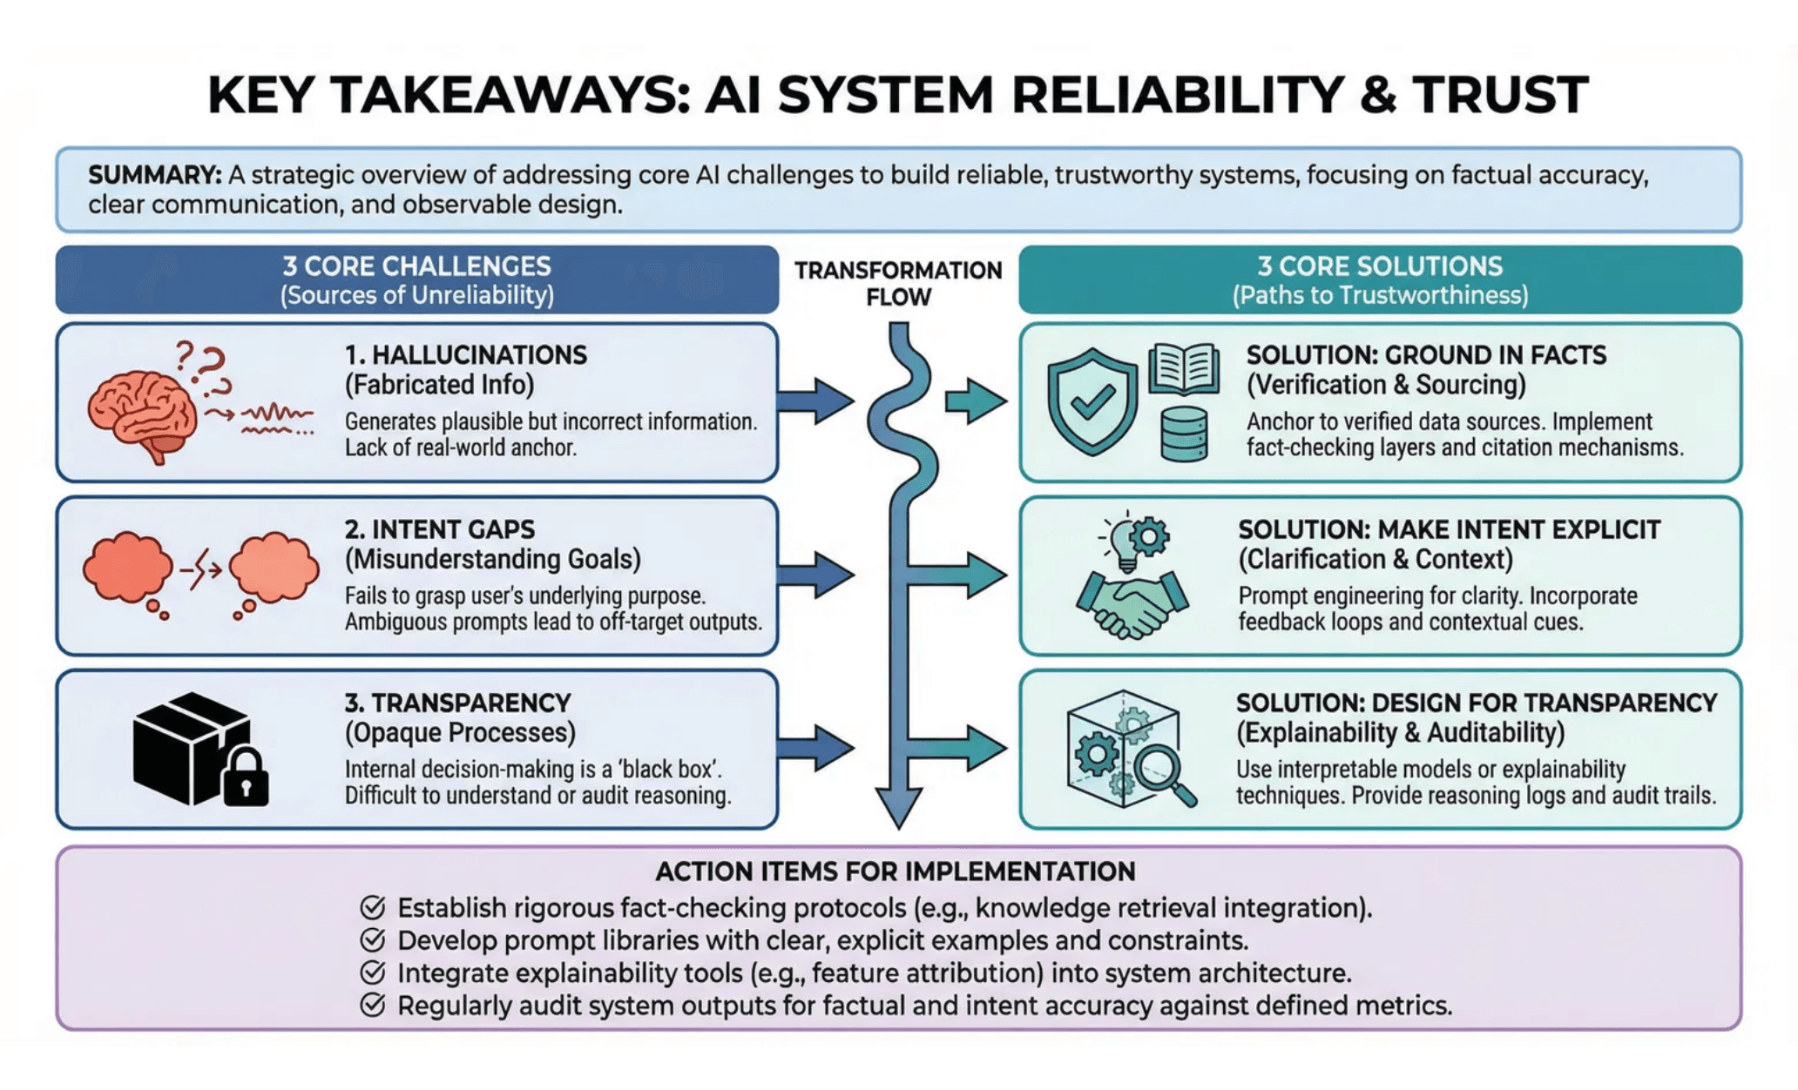
Summary
What You Need to Do Now
Your 30-Day Sprint
Week 1: Audit workflows for ambiguity
Week 2: Build RAG knowledge base
Week 3: Implement Verification Loops
Week 4: Launch Pilot Agent
"Start small, verify everything, scale trust."
Notes:
This entire session boils down to three core challenges and three core solutions. You must eliminate unreliability with RAG and verification, close the intent gap with disambiguation and clarification, and build trust through transparency and monitoring. Your 30-day sprint starts now. In Week 1, audit your current systems and identify your highest-risk use cases. Weeks 2 and 3 are about building the secure foundation: implement RAG for one critical application and build a basic evaluation harness. By Week 4, you should deploy a pilot agent with full monitoring and start collecting feedback. Remember this mantra: start small, verify everything, and scale trust. Now, let's open the floor for discussion.

Slide 33

The AI Orchestration Skill Tree
From Steering to Scaling: Four Levels of Mastery
Level 1
Conditioning & Steering
Level 2
Authority & Verification
Specify clear intent. Engineer context. Design constraints (schemas, rubrics, tool access).
Maintain human control. Design verification mechanisms. Ensure provenance and traceability.
Level 3
Workflows & Orchestration
Level 4
Compounding & Leverage
Decompose complex problems into pipelines. Build observability. Create failure taxonomies.
Build evaluation harnesses. Create feedback loops. Enable continuous improvement and scale.
The Factorio Analogy:
Begin by crafting (Level 1), automate (Level 2), orchestrate pipelines (Level 3), then create self-improving systems (Level 4).

Slide 34

Questions?
Let's discuss your agent strategy.
Next Steps
Contact
Download the full playbook and code samples at:
github.com/example/agent-training
For workshops and implementation support:
training@manus.im
Notes:
We've reached the final stage of our journey, and I hope you feel equipped to start building your own robust agent factory. Think back to that Factorio skill tree we discussed. We've unlocked the foundational technologies—RAG, Verification, Intent Disambiguation—and now it's time to put them to work. Your next step is not just to build an agent, but to build a reliable, trustworthy system that scales. Remember the three core solutions: ground your facts, make intent explicit, and design for transparency. This is how we move from theoretical possibility to real-world acceleration in 2026. We’ve provided a comprehensive playbook and templates to help you with your 30-day sprint. Now, let's open the floor. What challenges are you anticipating, and what questions do you have about starting your implementation?

